Slide 1
Makaton Signs of the Week
Summer Term 2

Slide 2



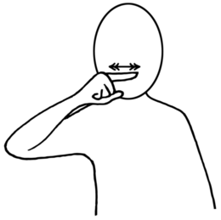
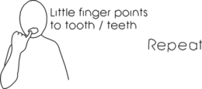
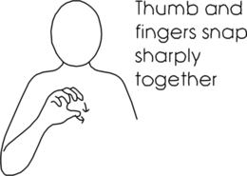
Signs of the Week: 5th June 2023 – Blue Group/Rainbow Group
Teeth
Toothbrush
Bite

Slide 3




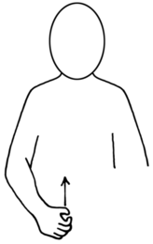

Signs of the Week: 5th June 2023 – Green Group/Red Group
Turtle
Bag
Sea

Slide 4





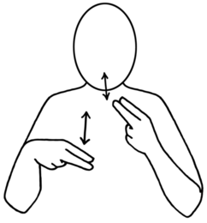
Signs of the Week: 12th June 2023
School
Rainbow
Lunch

Slide 5





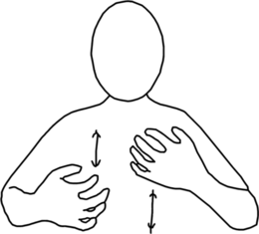
Signs of the Week: 19th June 2023
Worried
Excited
Independent

Slide 6
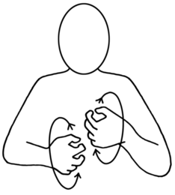



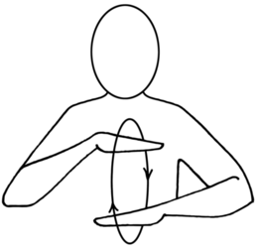
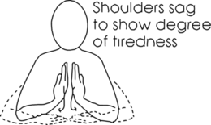
Signs of the Week: 26th June 2023
Angry
Calm
Tired

Slide 7






Signs of the Week: 3rd July 2023
Bus
Naughty
Dirty

Slide 8





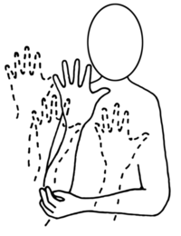
Signs of the Week: 9th July 2023
Pond
Baby
Woods/forest

