Slide 1

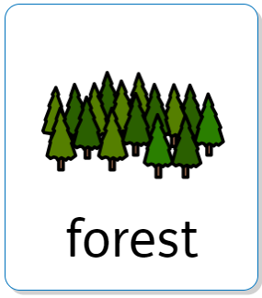


Week beginning 16th April 2023
Tidy by Emily Gravet
There’s a Rang-Tan in my bedroom by James Sellick
When there is too much water and it spills everywhere.
A large group of trees, bigger than a wood.
Notes:
NOTE: To change images on this slide, select a picture and delete it. Then click the Insert Picture icon in the placeholder to insert your own image.

Slide 2



Week beginning 24th April 2023
The Very Hungry Caterpillar by Eric Carle
The young of butterflies. Caterpillars hatch out of eggs laid by butterflies
A case made by a caterpillar to protect it while it changes into a butterfly.
Notes:
NOTE: To change images on this slide, select a picture and delete it. Then click the Insert Picture icon in the placeholder to insert your own image.

Slide 3

Week beginning 24th April 2023
The Very Hungry Caterpillar by Eric Carle
The young of butterflies. Caterpillars hatch out of eggs laid by butterflies
A flying insect that is brightly coloured.
Blue Group and Rainbow Group
Notes:
NOTE: To change images on this slide, select a picture and delete it. Then click the Insert Picture icon in the placeholder to insert your own image.

Slide 4
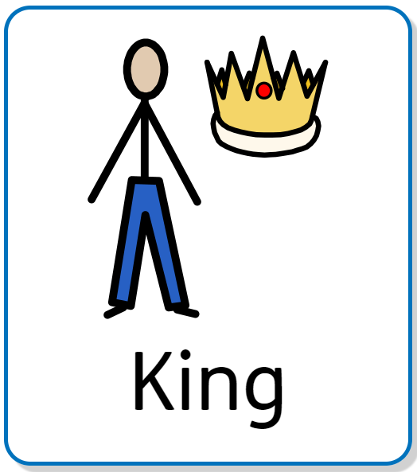


Week beginning 2nd May 2023
The King’s Runaway Crown by Rosalind Spark & Ian Smith
A name a person is given, who is the head of the country.
A feeling you get in your tummy when you are going to do something you are worried about.
Notes:
NOTE: To change images on this slide, select a picture and delete it. Then click the Insert Picture icon in the placeholder to insert your own image.

Slide 5

Week beginning 2nd May 2023
The King’s Runaway Crown by Rosalind Spark & Ian Smith
A name a person is given, who is the head of the country.
A good feeling you get when you are doing something you like.
Blue Group and Rainbow Group
Notes:
NOTE: To change images on this slide, select a picture and delete it. Then click the Insert Picture icon in the placeholder to insert your own image.

Slide 6
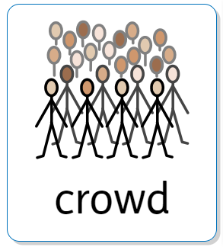
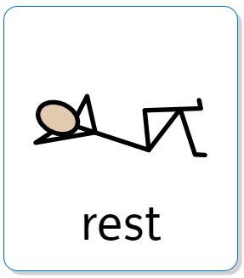

Week beginning 9th May 2023
The Kings Coronation by Marion Billet
A large group of people
When you are calm and not doing an activity.
Notes:
NOTE: To change images on this slide, select a picture and delete it. Then click the Insert Picture icon in the placeholder to insert your own image.

Slide 7
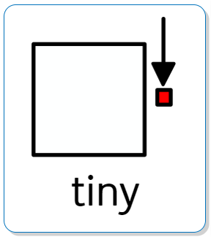


Week beginning 15th May 2023
Titch by Pat Hutchins
Something that is
very small.
When something gets bigger. ‘The seed grew into a big plant’
Notes:
NOTE: To change images on this slide, select a picture and delete it. Then click the Insert Picture icon in the placeholder to insert your own image.

Slide 8

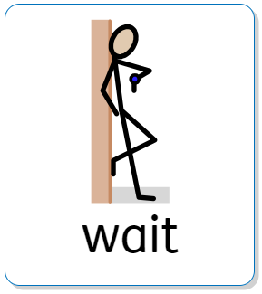

Week beginning 22nd May 2023
Jasper’s Beanstalk by Nick Butterworth & Mick Inkpen
A tool for collecting or moving things, when gardening.
To stay in a place until something you are expecting happens.
Notes:
NOTE: To change images on this slide, select a picture and delete it. Then click the Insert Picture icon in the placeholder to insert your own image.

