Slide 1
St Paul’s Nursery School
Words of the Week 2022/23
Linked to our book of the week

Slide 2
Autumn 1

Slide 3
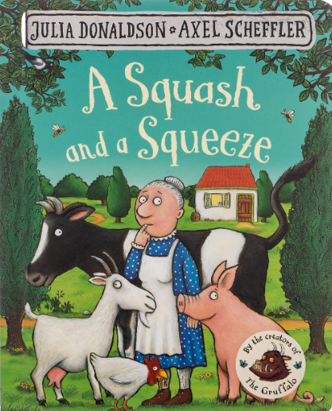
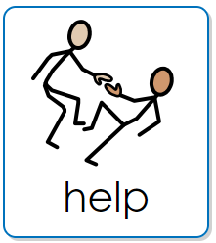
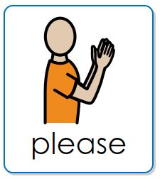
Week beginning : 12th September 2022
A Squash and a squeeze by Julia Donaldson
To make it easier for someone to do something.
Used to ask for something nicely.

Slide 4

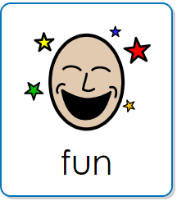

Week beginning : 19th September 2022
The Abilities in Me – Down’s Syndrome by Gemma Keir
To enjoy something that you are doing.
To feel comfortable, away from danger.

Slide 5
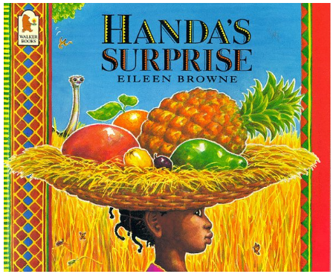
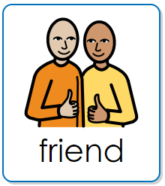

Week beginning : 26th September 2022
Handa’s Surprise by Eileen Browne
A person who you like to spend time with.
When something unexpected happens.

Slide 6

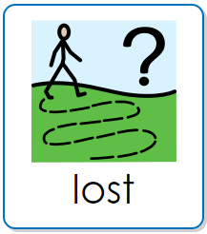

Week beginning : 3rd October 2022
Lost and Found by Oliver Jeffers
When you cannot find something or someone.
When you see what you have been looking for.

Slide 7

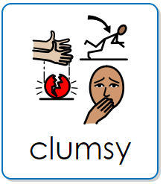

Week beginning : 10th October 2022
Giraffes can’t Dance by Giles Andreae
When you find something a bit tricky to do.
When really like something or someone.

Slide 8

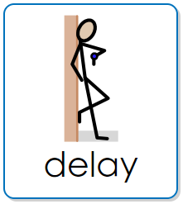
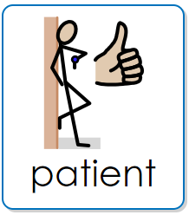
Week beginning : 17th October 2022
The Abilities in Me – Speech Delay by Gemma Keir
When something is late, or you must wait.
To not get cross when something is late.

Slide 9
Autumn 2

Slide 10
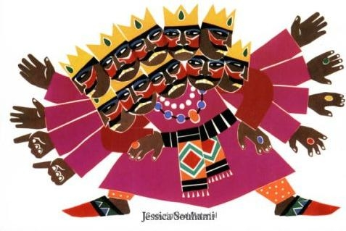
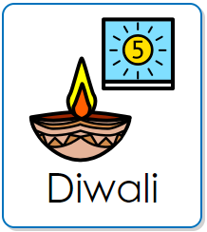

Week beginning : 31st October 2022
Diwali Story by Jessica Souhami
The Hindu festival of Lights.
A piece of land surrounded by water.

Slide 11
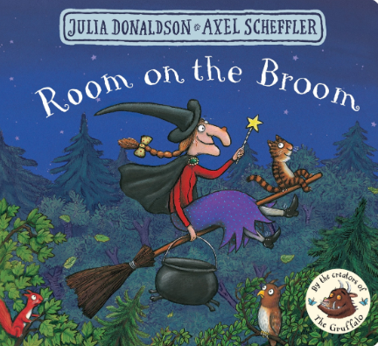
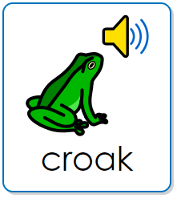
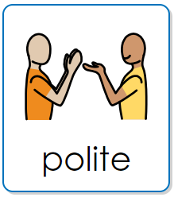
Week beginning : 7th November 2022
Room on the Broom by Julia Donaldson
The noise a frog or toad makes.
When you are kind to others.

Slide 12
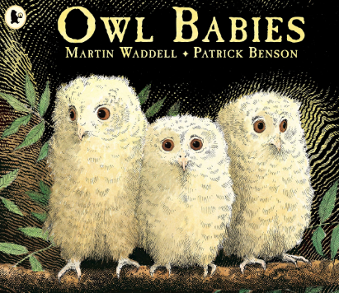
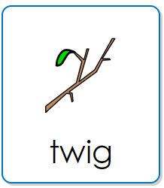

Week beginning : 21st November 2022
Owl Babies by Martin Waddell
A small woody shoot growing from a branch.
Not making a sound or a noise.

Slide 13
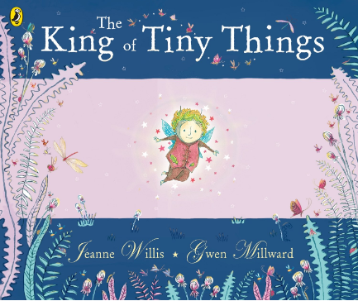

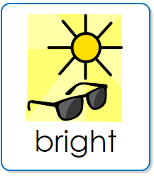
Week beginning : 21st November 2022
The King of the Tiny Things by Jeanne Willis
A dark area on an object where light is blocked.
Something giving out a lot of light.

Slide 14


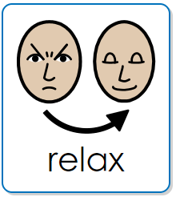
Week beginning : 28th November 2022
I am Stronger than Anxiety by Elizabeth Cole
When you feel worried about something.
To become less worried or anxious.

Slide 15
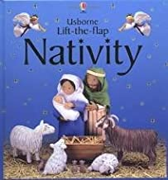
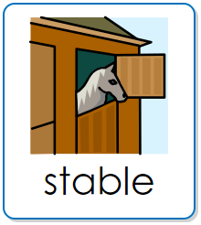
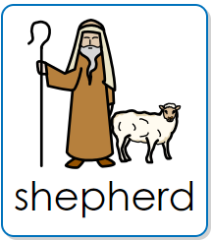
Week beginning: 5th December 2022
The Nativity – by Felicity Brooks and Jo Litchfield
A building where you keep horses and animals.
A person who looks after sheep.

