Slide 1
Makaton Signs of the Week
Summer Term 1

Slide 2

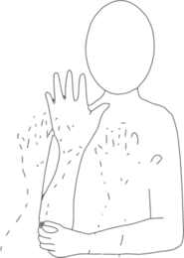
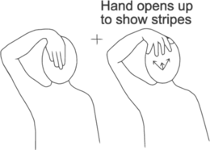
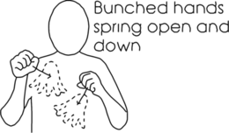


Signs of the Week: 16th April 2023
Rubbish
Forest
Badger

Slide 3




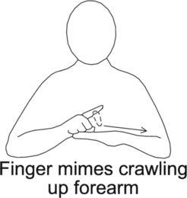

Signs of the Week: 24th April 2023
Butterfly
Caterpillar
Egg

Slide 4



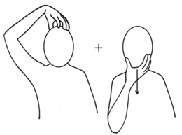

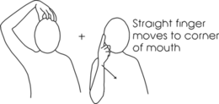
Signs of the Week: 1st May 2023
King
Queen
Crown

Slide 5






Signs of the Week: 9th May 2023
Boat
Car
Bus

Slide 6



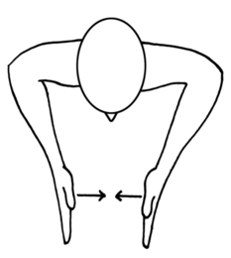

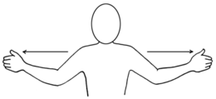
Signs of the Week: 15th May 2023
Small
Big
Seeds

Slide 7



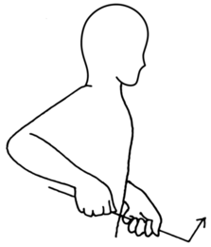
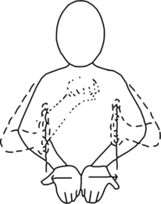
Signs of the Week: 22nd May 2023
Dig
Bucket
Spade

