Slide 1
Makaton Signs of the Week
Autumn Term 1

Slide 2


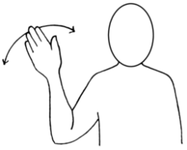



Signs of the Week: 6th September 2022
Hello
Goodbye
Toilet

Slide 3

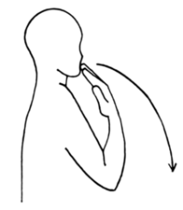

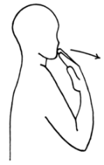


Signs of the Week: 12th September 2022
Please
Thank you
Help

Slide 4


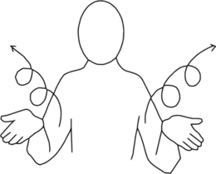



Signs of the Week: 19th September 2022
Safe
Play
Yes

Slide 5






Signs of the Week: 26th September 2022
Friend
No
Food

Slide 6






Signs of the Week: 3rd October 2022
Boy
Girl
Cold

Slide 7


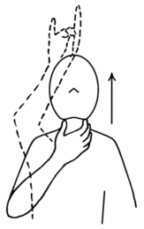

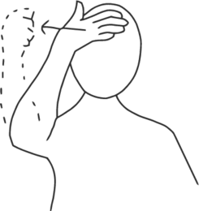

Signs of the Week: 10th October 2022
Animals
Giraffe
Hot

Slide 8





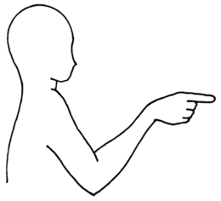
Signs of the Week: 17th October 2022
Speak
Me
You

