Slide 1
Makaton Signs of the Week
Autumn Term 2

Slide 2
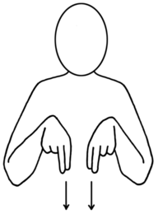

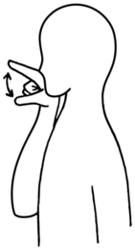

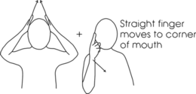

Signs of the Week: 31st October 2022
Dog
Witch
Bird

Slide 3






Signs of the Week: 7th November 2022
Light
Rama
Sita

Slide 4



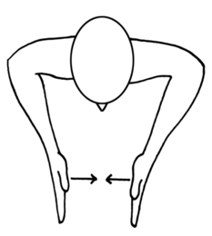
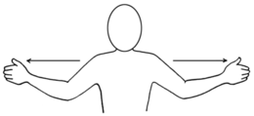

Signs of the Week: 14th November 2022
Big
Small
Bear

Slide 5




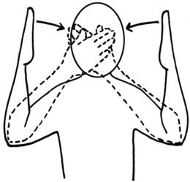
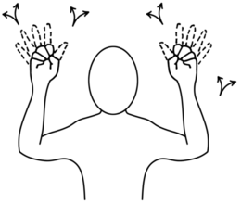
Signs of the Week: 21st November 2022
Night
Moon
Stars

Slide 6



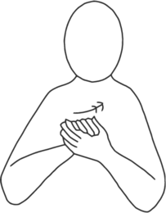
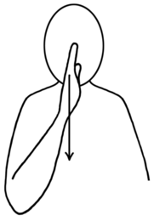

Signs of the Week: 28th November 2022
Happy
Sad
Anxious

Slide 7


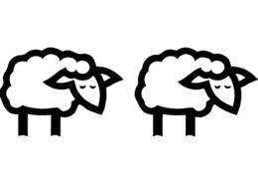
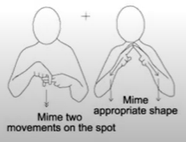
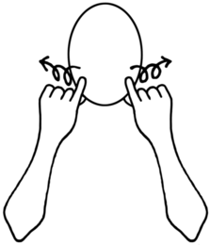

Signs of the Week: 5th December 2022
Christmas
Stable
Sheep

