Slide 1
Makaton Signs of the Week
Spring Term 1

Slide 2

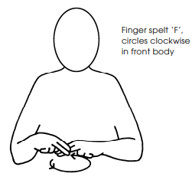
Signs of the Week: 3rd January 2023
Family
Welcome

Slide 3
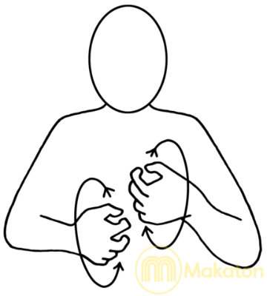

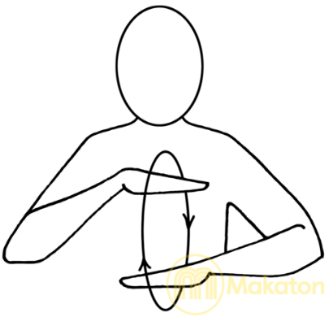



Signs of the Week: 9th January 2023
Angry
Frightened
Calm

Slide 4

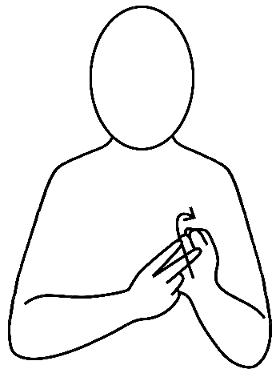



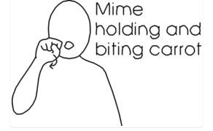
Signs of the Week: 23rd January 2023
Vegetables
Carrot
Chips

Slide 5

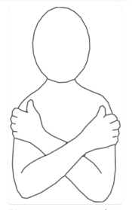

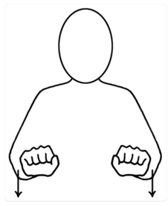
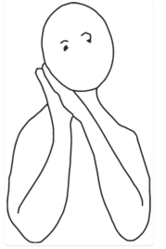

Signs of the Week: 23rd January 2023
Bear
Chair
Bed

Slide 6




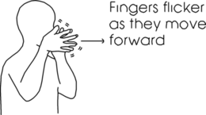
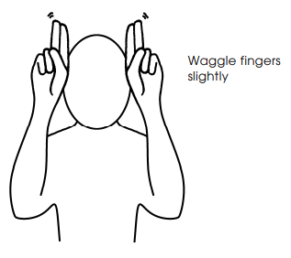
Signs of the Week: 30th January 2023
Pig
Rabbit
Dragon

Slide 7





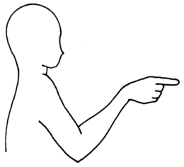
Signs of the Week: 6th February 2023
Speak
Me
You

Slide 8
Makaton Signs of the Week
Spring Term 2

Slide 9

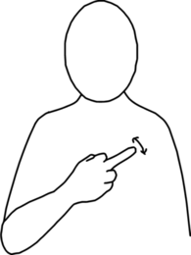


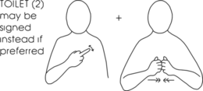

Signs of the Week: 20th February 2023
Toilet
Toilet Paper
Wash Hands

Slide 10
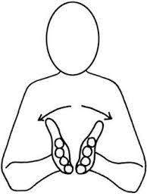




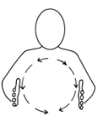
Signs of the Week: 27th February 2023
Book
World
To read

Slide 11



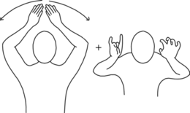

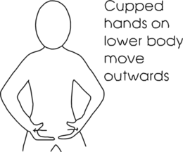
Signs of the Week: 6th March 2023
Alien
Love
Pants

Slide 12
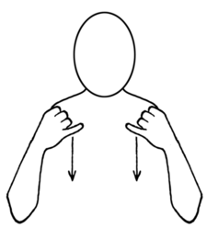
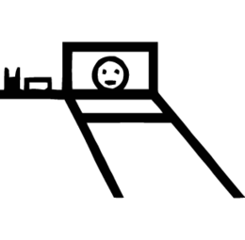


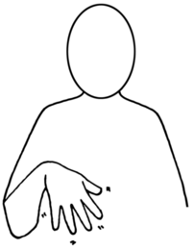
Signs of the Week: 13th March 2023
ill
pain
Space rocket

Slide 13

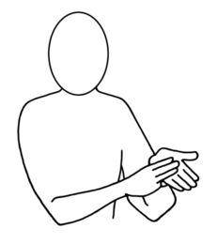


Signs of the Week: 20th March 2023
Mummy
Daddy
Space

Slide 14





Signs of the Week: 27th March 2023
Friend
Nursery School
Sock

