Slide 1


Use of Visuals in the Early Years

Slide 2




Aims of the session...
To understand what visual strategies are.
To understand why the use of visuals is so important.
To understand when you might use visual strategies.
The use of visuals to aid in social communication.

Slide 3



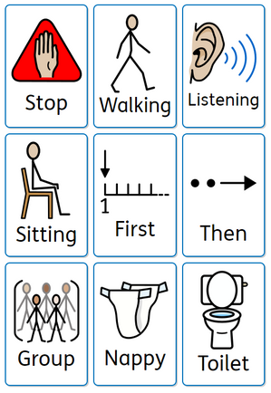
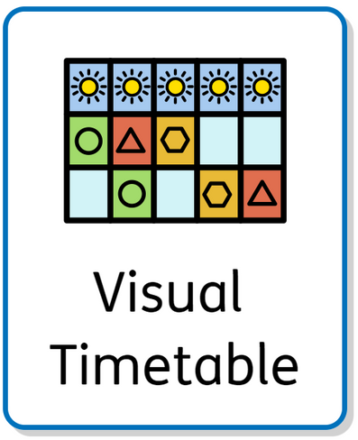
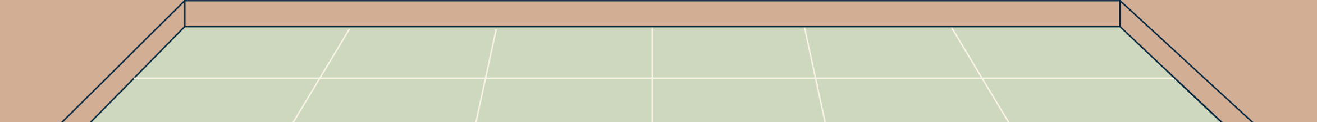
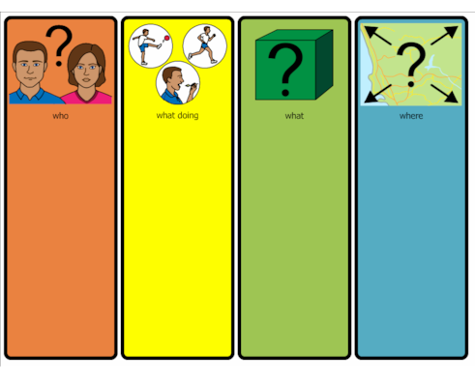
What is a visual strategy?
A visual strategy is a way of adding to information that you are giving verbally. Children who have Autism or speech and language differences often work more visually than auditory so using supporting strategies is important. This can be done in a variety of ways.
Visuals

Slide 4










We use visuals all the time...possibly without even realising...

Slide 5
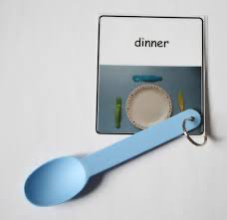
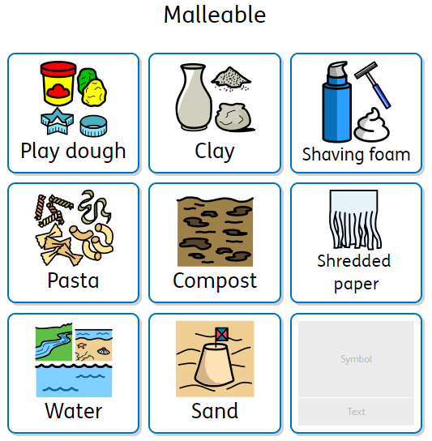

Examples of Visuals that can be used in Early Years
Visuals of instructions and transitions
Visual Timetables
Colourful Semantics
Objects of Reference
Name Cards
Choice boards

Slide 6
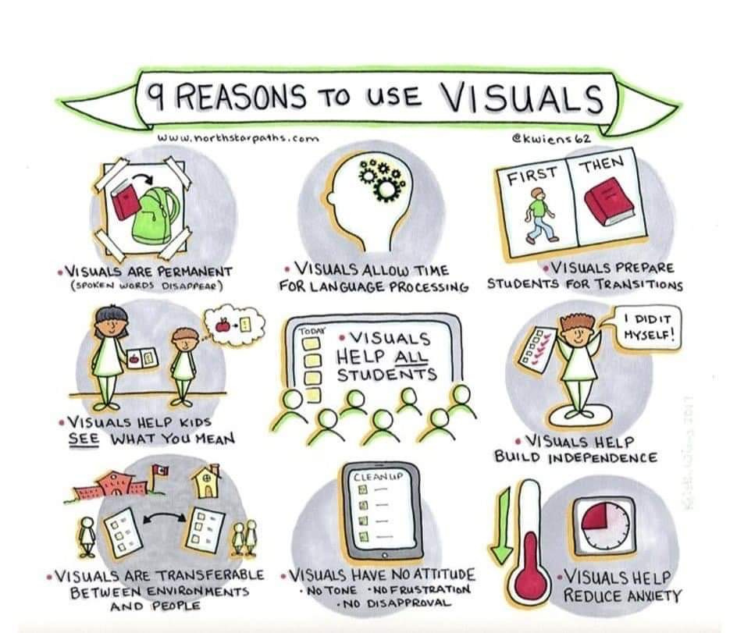



Enable others
to 'see'
the task.
www.northstarpaths.com
Notes:
Visuals tend to be a little more permanent than words.
They allow people time to process the language that is involved, don't be afraid to repeat an instruction whilst holding a visual up.
They help scaffold transitions between activities and times of the day. Using a visual timetable or first and then cards. They are allowing children time think about what is happening in the present and then in the future.
It a visual representation of what you are wanting a child to understand.
They help ALL students, not just those who need them to transition and also help support adults.
They can be used to build independence in learners, knowing what to do and in what order.
You can take them with you, transferable between settings and people.
A child, who may be neuro diverse may find the nuance of speech tricky 'what did they mean by that? How do I know what that tone of voice means?' They have no attitude they are a pictorial representation of language.
They help to reduce the anxiety of being in setting.
They help develop understanding of the spoken work.

Slide 7
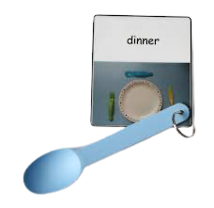

Objects of Reference
https://www.youtube.com/watch?time_continue=5&v=NlBMB6A3Axs&embeds_referring_euri=https%3A%2F%2Fhubblecontent.osi.office.net%2F&source_ve_path=MjM4NTE&feature=emb_title
Notes:
2.41 - 5.20 talking about how to use Obj of Reference (Introducing them)
Sums up the use of objects of reference and how to start.

Slide 8
Visuals
- for transitions - pictures instead of objects
Notes:
Objects of reference are really important as a starting point to aid in transition as what the SCERTS approach would call 'Transactional Support'
This is a continuation/next step in this journey of using visuals
The first step is to use photos of the object/room/activity/instruction that you may want to convey. This can be a picture of the object of reference that you have moved from - or something new. Continuity can be the best thing in this case - I would suggest that you have the written word as well under the picture to aid in transition but also helps develop word recognition.
- Then moving to a more abstract picture.

