Slide 1


Inclusive Group Teaching
in Nursery Settings

Slide 2

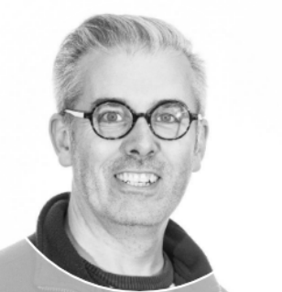
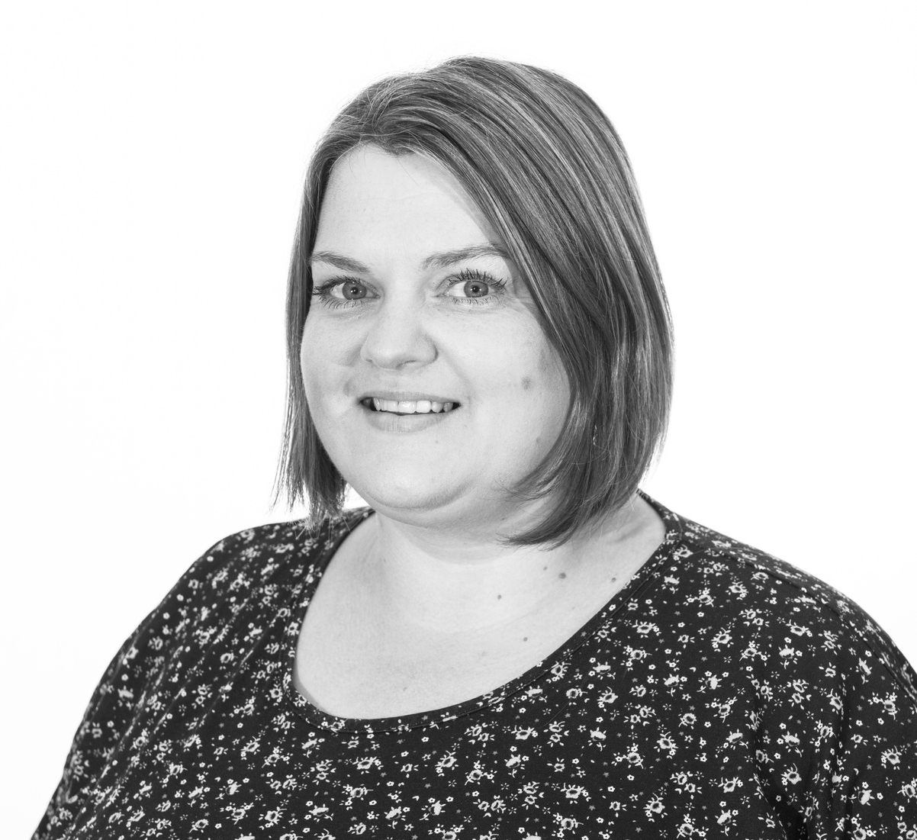



Martin Cumming
Inclusion Leader
St Paul's Nursery School
Sarah Lomas
Senior Practitioner for Inclusion and Wellbeing

Slide 3


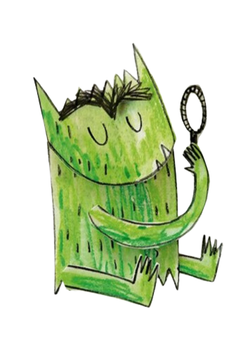
Aims of today's session:
  To understand what is meant by inclusion.
  To understand how we can plan for inclusion within groups in our settings.
  Organisation - how to manage resources, people and children.

Slide 4

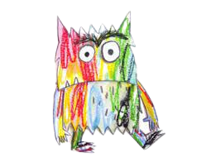

What do we mean by inclusion?

Slide 5

The Law...
Equality Act 2010 - Protected Characteristics:
  age
  disability
  gender reassignment
  race
  religion or belief
  sex
  sexual orientation
  marriage and civil partnerships
  pregnancy and maternity

Slide 6

In the Early Years....
'Effective inclusive practice provides all children with access to opportunities and support during the earliest and most influential years of their learning and growing. It also helps enable children to be confident in who they are and what they aspire to in the future.'
Early Years Alliance

Slide 7
In practice this means...
Being flexible in how we teach (pedagogy)
Knowing what we want the children to learn
Being consistent in the approaches we take
Ensuring that our teaching is accessible in the best way it can be
All opportunities are learning opportunities
(not only for children but as reflective practitioners)
Knowing where to get help and support

Slide 8

"If a child can’t learn the way we teach, maybe we should teach the way they learn”
Ignacio Estrada

Slide 9
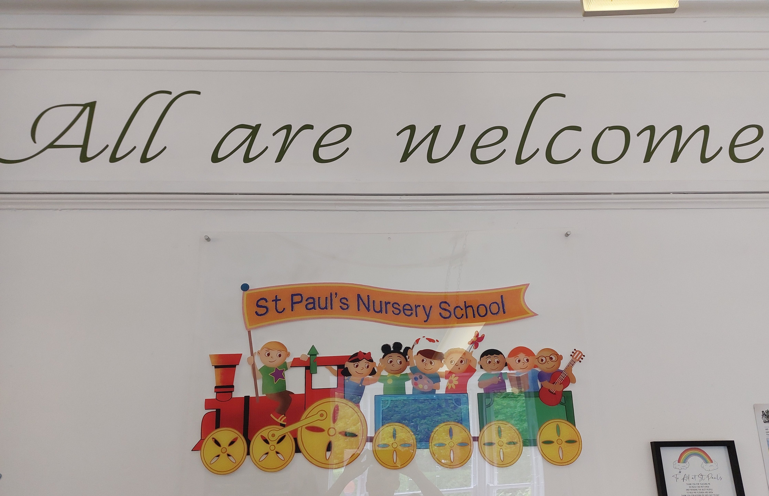
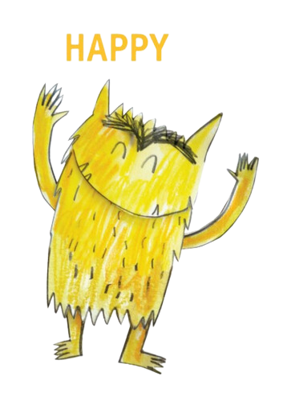
All are welcome....
An ethos to live by...

Slide 10





Talk to parents
Observe - O.W.L. or PLOD
Star Observation Chart...
Know your child
Play
Child Centred
Assessments
  What are their strengths?
  What do they need support with?
Notes:
If we don't know our children then how do we know how best to support them?

Slide 11

Group time Structure

Slide 12
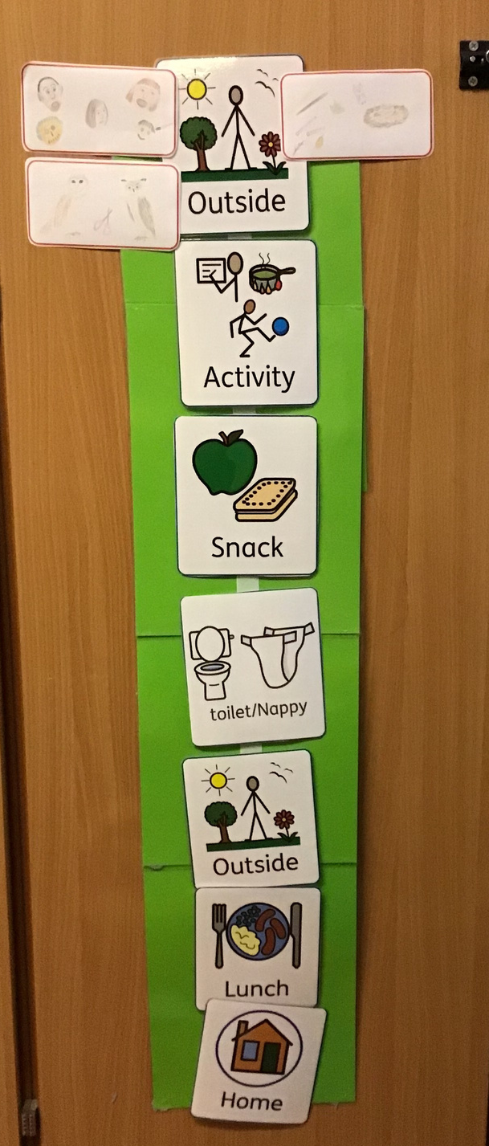
Visual timetable...
Children understanding what is
happening now and next...
Aids in transactional support, especially
for those children who may find
transitions difficult or changes in routine.
Helps all children.

Slide 13
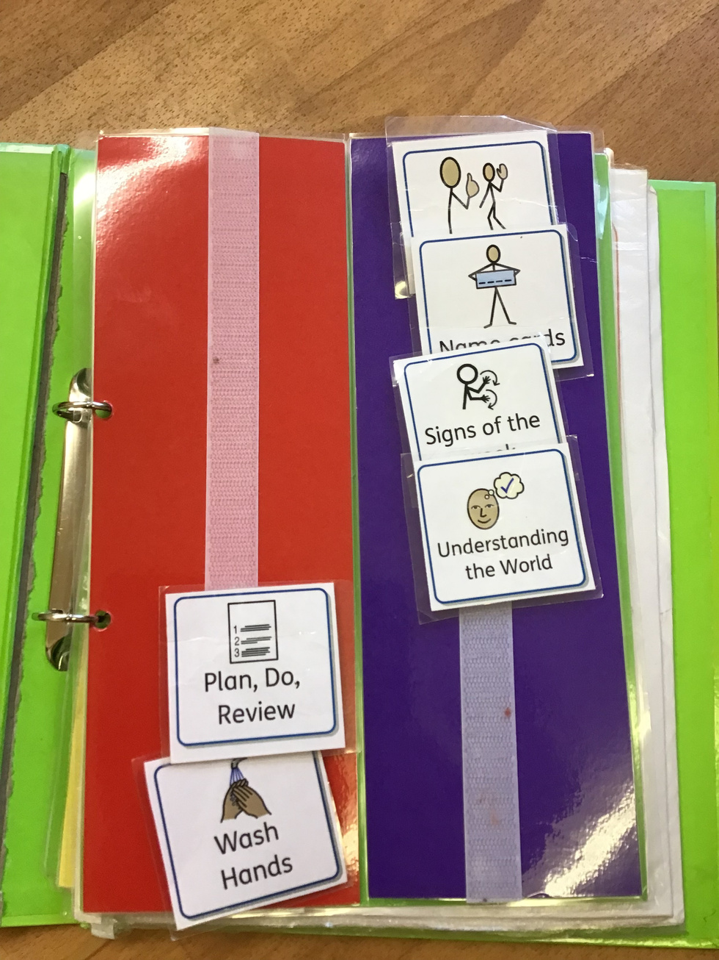
What does group teaching look like...session breakdown
Visual support
Works on the same basis as a visual timetable but can be used in small group sessions.
Sets out routine
Children know when something is started and then finished.
Move each tile after each activity finished.

Slide 14
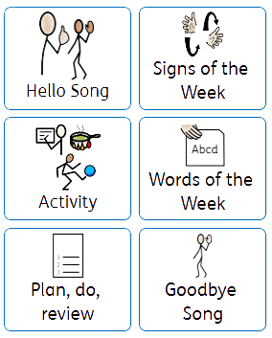
Hello Song -
Words of the Week -
Signs of the Week-
Main focus of the session
(UTW/PSED/Wellcomm etc)
Plan, Do, Review
Goodbye song

Slide 15
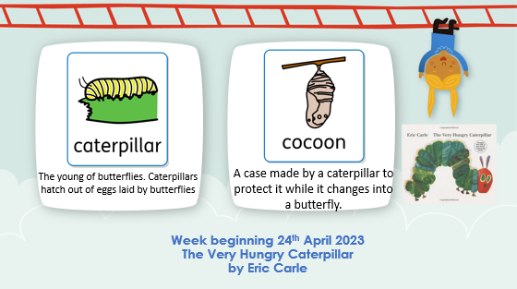
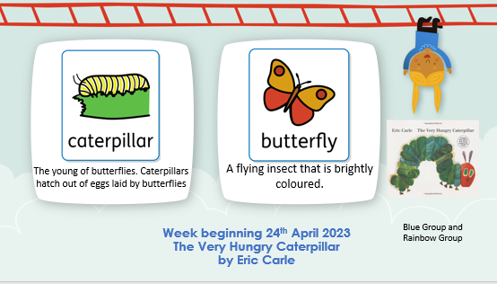
Introducing new language linked to our book based curriculum
Language - Differentiated for Our older children

Slide 16
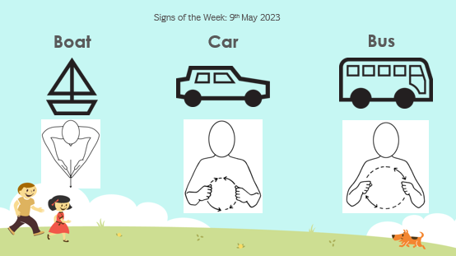
Makaton teaching - other forms of communication
117 signs a year plus those learned through singing songs

Slide 17
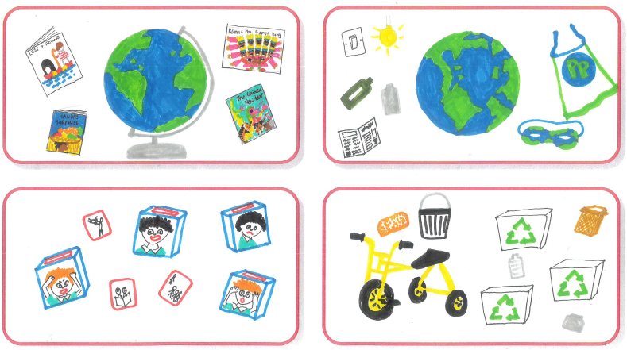
Plan, Do, Review...
What would the child like to do when back in setting?
Helps with children making choices.

Slide 18

Children may need support to be able to join in group times.
This could be in a variety of ways, either through adult support, sensory support or visual support and props.
The type of support that a child may need may change from session to session and
can be trial and error.
Finding the right support can make a
huge difference to teaching times.
Support...

Slide 19
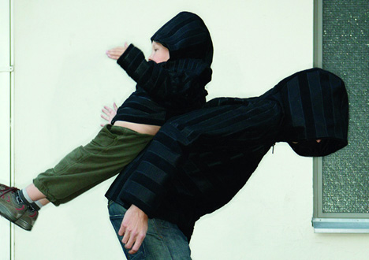
Adult support....
If staff are available, adult support can benefit the progress that children make in teaching times.
Support staff should help support but at the same time promote independence.Where possible children should not become reliant on adult support.
Promoting independence rather than Velcro Veras

Slide 20



Divide and conquer!
If possible, try to split a group depending on need.
In setting we often split our new starters with those who have been in group for a while so that we can more easily differentiate. (Often across a broad area of needs)
When support staff are a little less experienced can you get them to support in AOP whilst you teach one group and then the other?

Slide 21


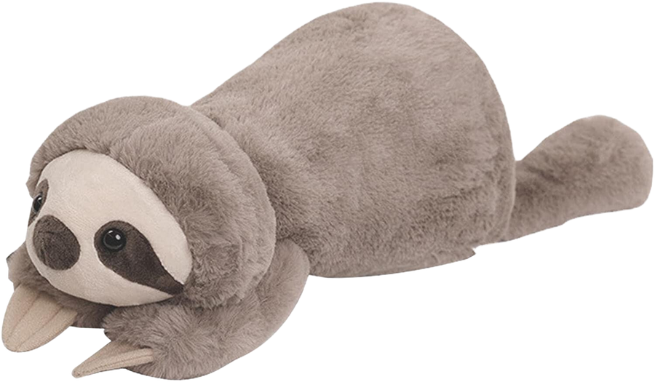

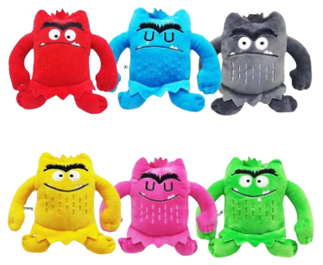

Sensory support

Slide 22
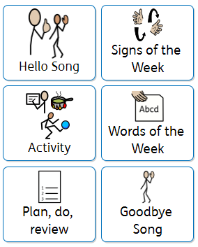
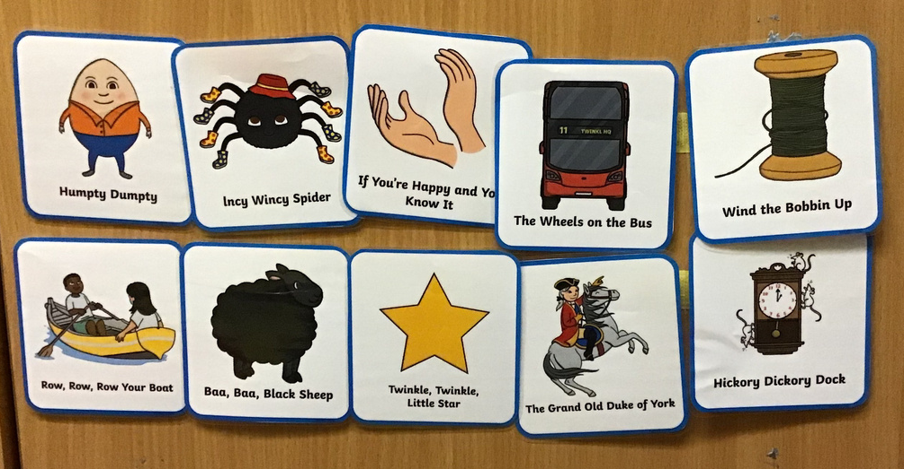
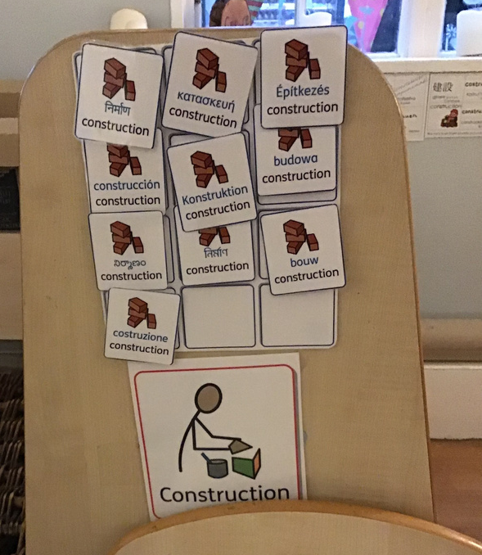
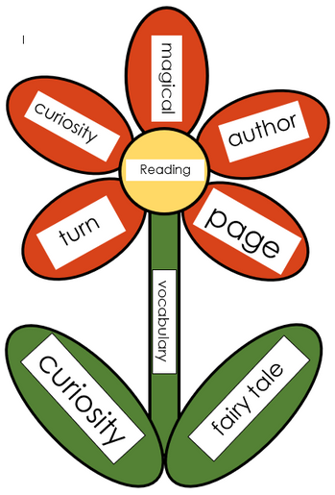
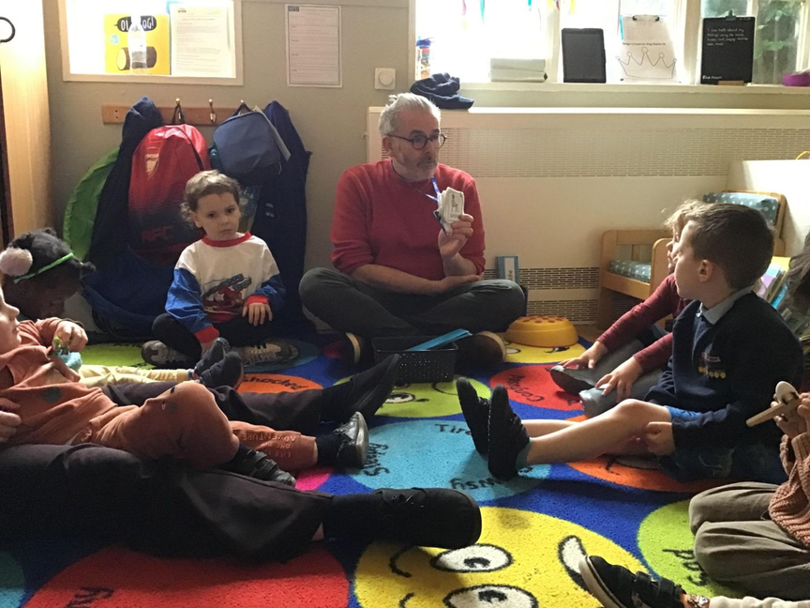
Visual Support

Slide 23
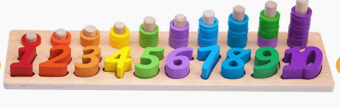
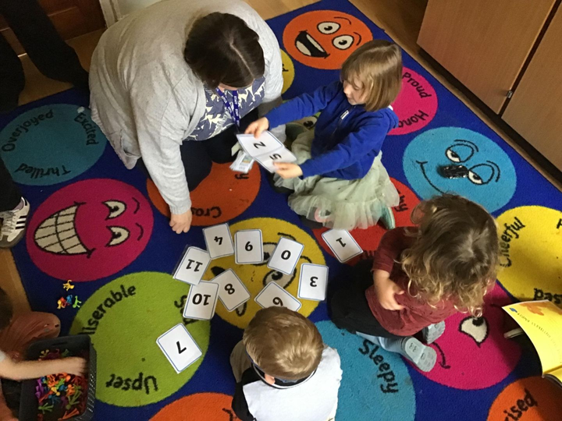
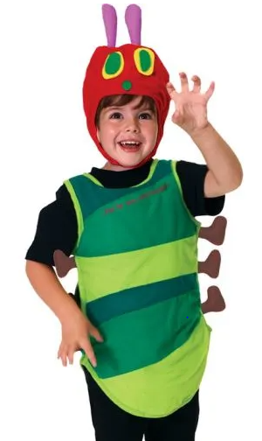

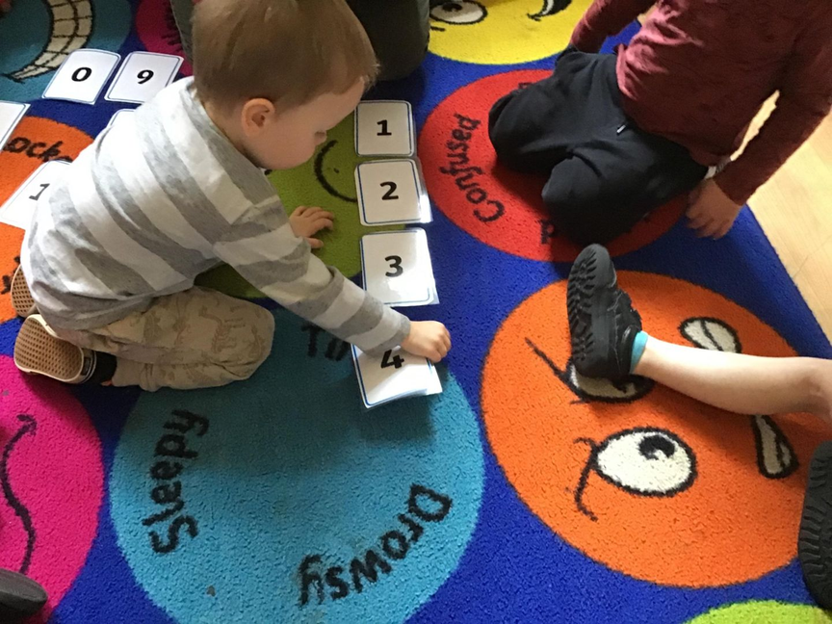
Props/Resources

Slide 24

Planning and delivering a group time based on the book: The Very Hungry Caterpillar by Eric Carle

Slide 25
Planning -
We have the text now think of the focus and learning outcome...
What would you like the children to learn from the story?
For example:
-naming the foods in the story
-naming the days of the week
-language of size, colour etc.

Slide 26

WHO - who is in my group and what are their needs?
  visual/hearing difficulties
  attention span - do they need their own set of resources to interact?
  does it need to be very physical and interactive for learners who aren't ready to sit and read a full story?
  props that you may be able to use for telling the story.

Slide 27

How are we going to meet the needs of the children?
  Alice - needs to be near me and can be my helper, needs some focus in session and handing out resources will help.
  James - sits on his own chair just outside of circle as not ready to join yet, may need chewy or fidget toy.
  Leon - needs a photocopy/copy of the book to look through at his own pace.
  Carrie - needs characters /toys/ pictures to lay out the story in front of me as I read

Slide 28
What strategies do I need to use in my group time?
Do I have...a balance of activities?
    songs
    actions
    physical activity to motivate all children
    music
How is my environment going to be set out? How are the children going to sit?

Slide 29
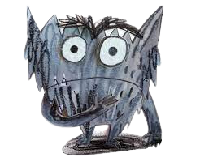
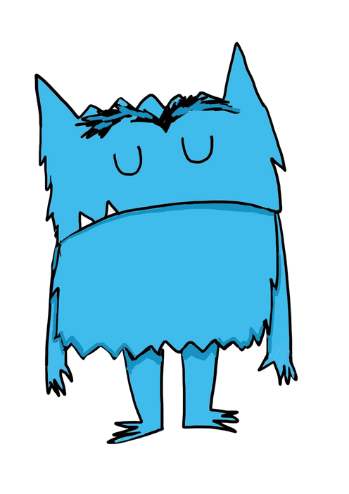
Through the session...
If children arent involving themselves why not?
Do they need fidgit toys?
Do you need to ask specific questions?
Is my language appropriate to their age and development? Too tricky?
Is the length of group time too long?

Slide 30
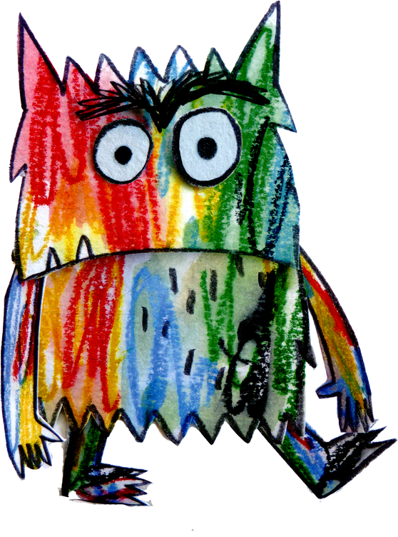

Do we set good behaviour expectations
Visuals for good looking, sitting and listening
Use older children as role models -
'Well done Lori you are sitting ready to listen.'

Slide 31
Setting the tone...
Tone and voice of person leading the group...
Are you excited? motivated? happy to be there?
using targeted praise? - if you say that one child is sitting well others will follow.

Slide 32
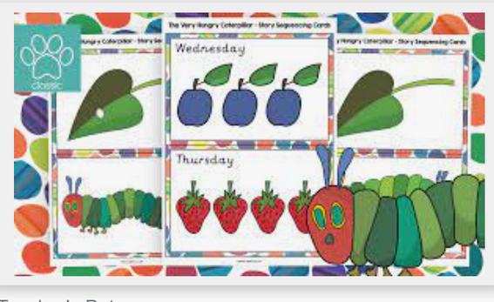
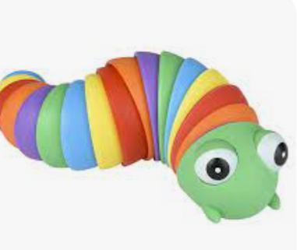
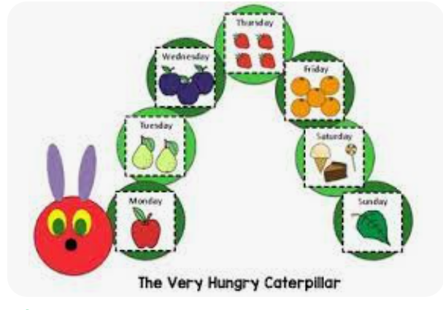
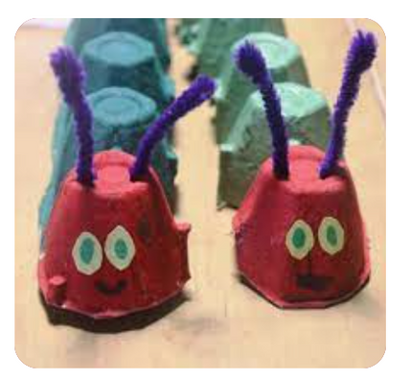
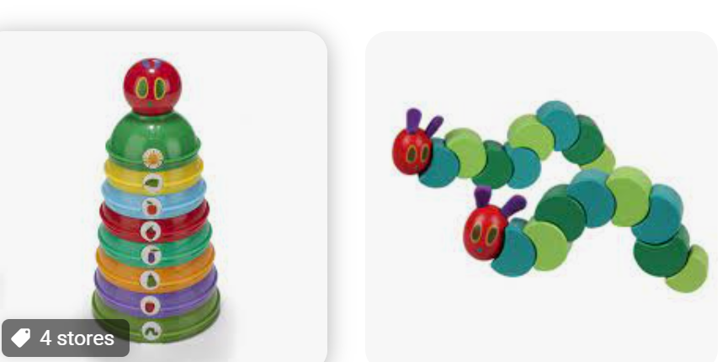
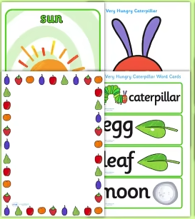
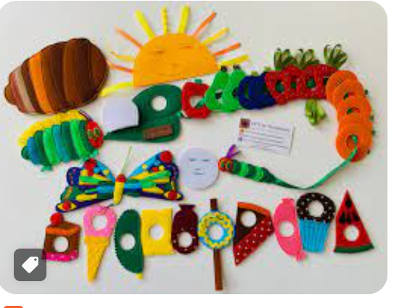
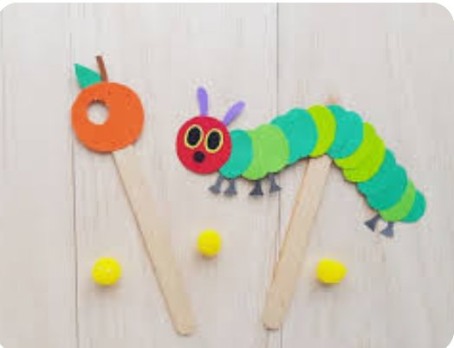
Remember story sacks? perfect for this!

Slide 33

Now your turn...
Think about what you would include in a group time reading this story...focus environmental sounds/animal sounds
How would you support children with SEND?
(Think about children in your setting)

Slide 34
Think about these things when planning your activity.
  what
  who
  how
  what will I need
  strategies and resources

Slide 35

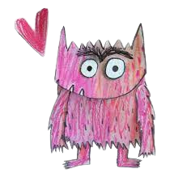

Slide 36
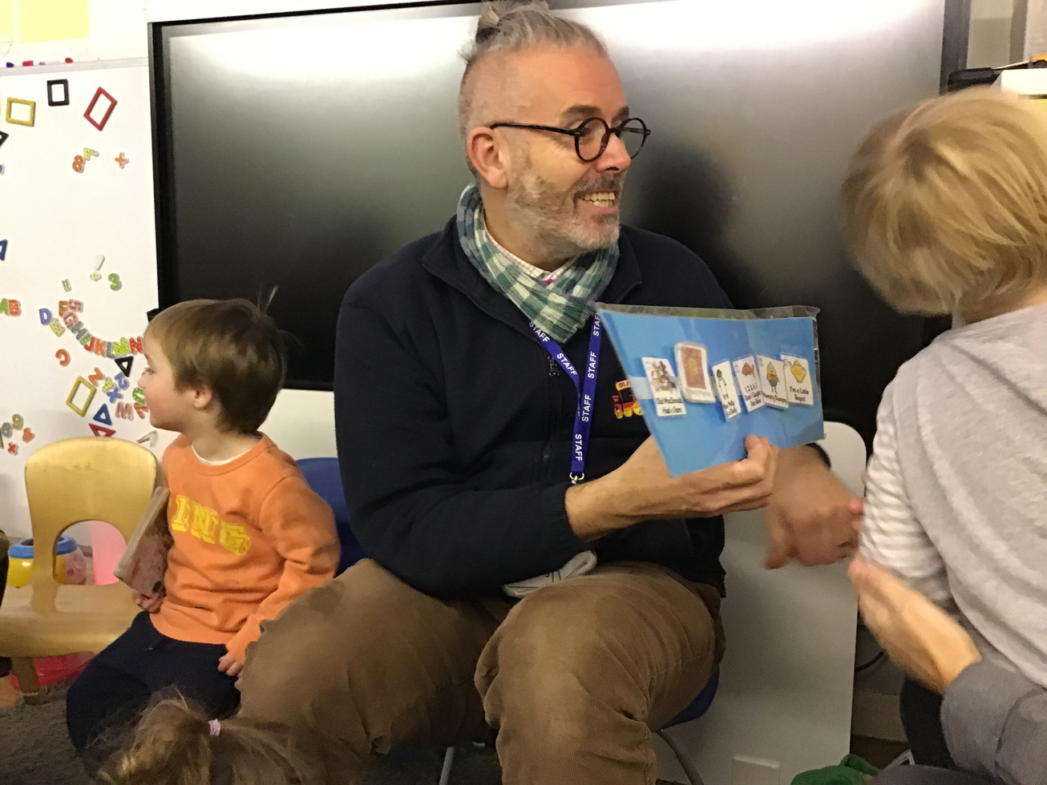
Communication Group -
Developing Social Communication
Developing communication skills for children with SEND (some pre verbal)
Can be run with just your target children or with a mixture of children (role models).
Building communication and interaction.
Again - using visuals to support

Slide 37

Communication Group -
Developing Social Communication
Typical Breakdown of session:
Hello Song - with choosing name cards
Choosing activity - such as instruments
Choice board for singing
Wiggle/Lycra/Foil Blanket
Goodbye Song

Slide 38
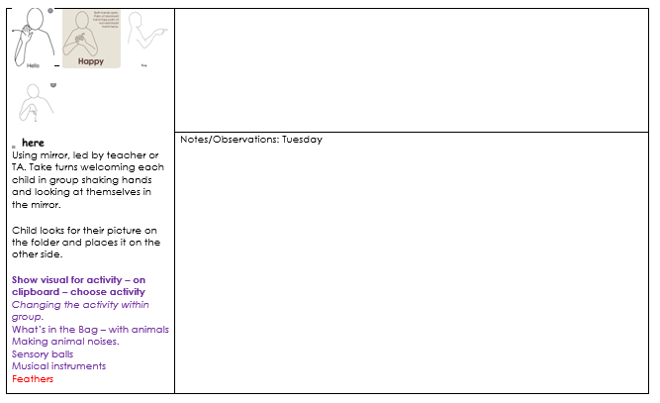
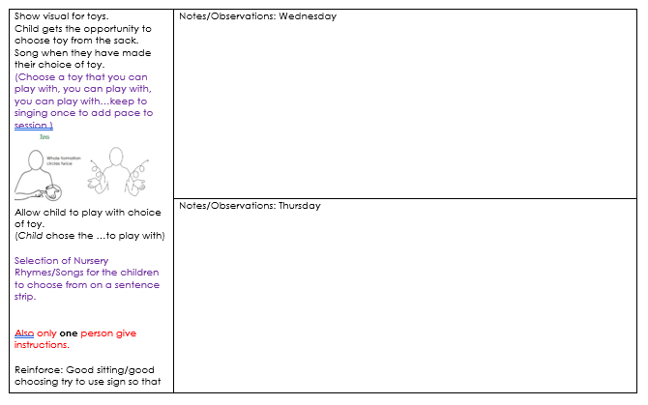
Communication Group -
Planning

