Slide 1

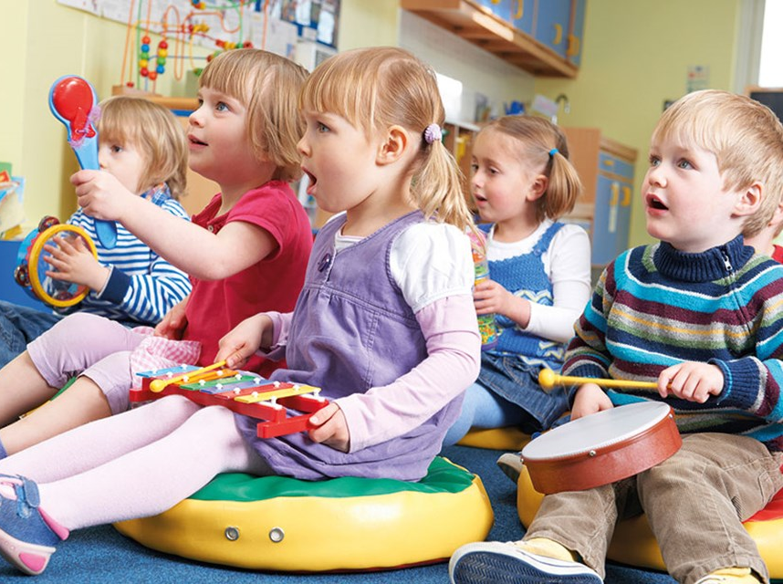
Musical and Intensive Interaction in Practice
22nd February 2023

Slide 2

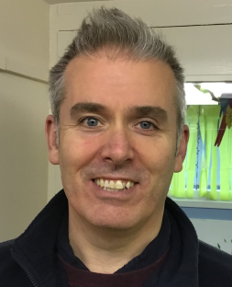
Course leaders…
Sarah Lomas
Senior Practitioner for Inclusion and Wellbeing
SENCO & ELSA
Sarah.lomas@stpaulsnursery.yorkschools.net
Martin Cumming
ERP Lead Techer and SENCO
m.cumming@stapaulsnursery.yorkschools.net

Slide 3
Course Objectives…
To develop an understanding of how musical/intensive interaction can be used to develop social communication.
To learn about practical ways to incorporate musical interaction into everyday practice.
To share practical advice of how we use musical interaction in setting.

Slide 4
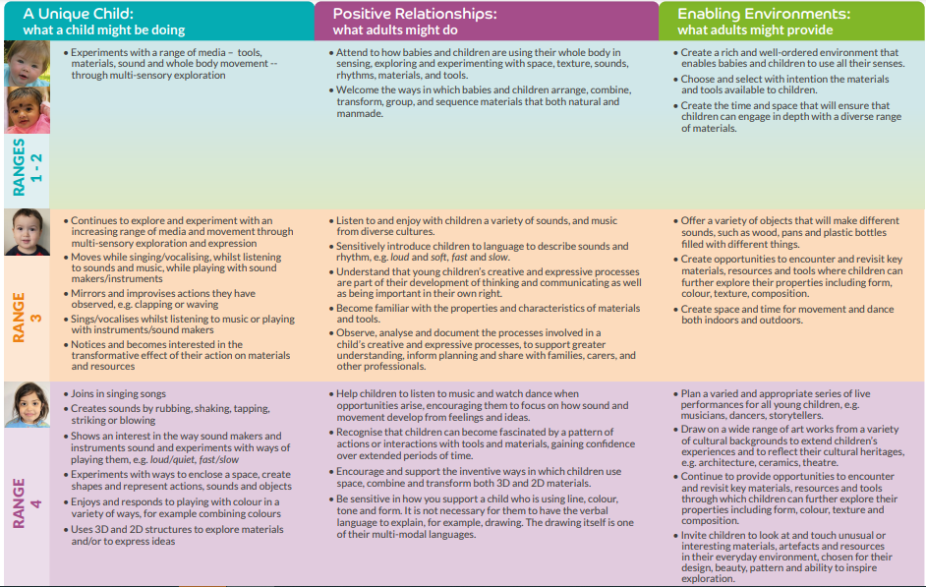
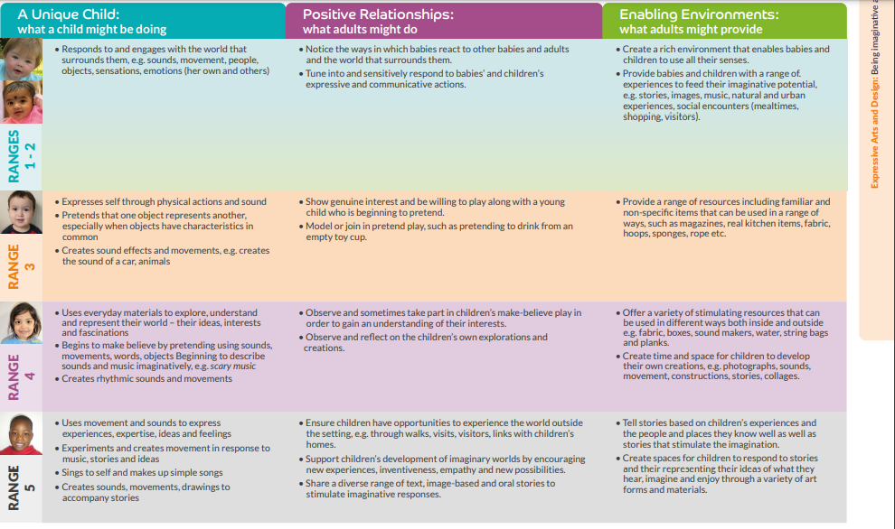
Where does music fit in the Early Years?
Birth – 5 matters
Communication and Interaction:
Listening and Attention
Expressive arts and Design:
Creating with Materials
Being Imaginative.
Notes:
Birth to 5 matters – All the way back in Ranges 1-2 Music plays an important part of children’s development. In positive relationships states that ‘ Attend to how babies and children are using their whole body in sensing, exploring and experimenting with space, texture, sounds, rhythms, materials and tools.
It is a vitally important step in learning to explore the world around and also to communicate with others, through shared participation and in some sense communication.

Slide 5

Choose stories with repeated refrains, dances and action songs involving looking and pointing, and songs that require replies and turn-taking.
Sing songs and encourage repetitive action rhymes.
Introduce “rhyme time” bags…encourage taking these home, and involve parents in rhymes and singing games.
Enjoys rhymes and demonstrates listening by trying to join in with actions or vocalisations
Sing songs and rhymes during everyday routines.
Moves whole body to sounds they enjoy, such as music or a regular beat
Encourage repetition, rhythm and rhyme by using tone and intonation as you tell, recite or sing stories, poems and rhymes from books.
Listens to familiar sounds, words, or finger plays

Slide 6
What do we mean by Musical Interaction?
1:1 or small group time with an adult using Musical Instruments, songs etc to develop communication and interaction with others.
Works for all children but can be used as a focus for those with Communication and interaction differences and Speech, Language and Communication Needs.
Should be fun but also a little repetitive. This helps with routine.

Slide 7
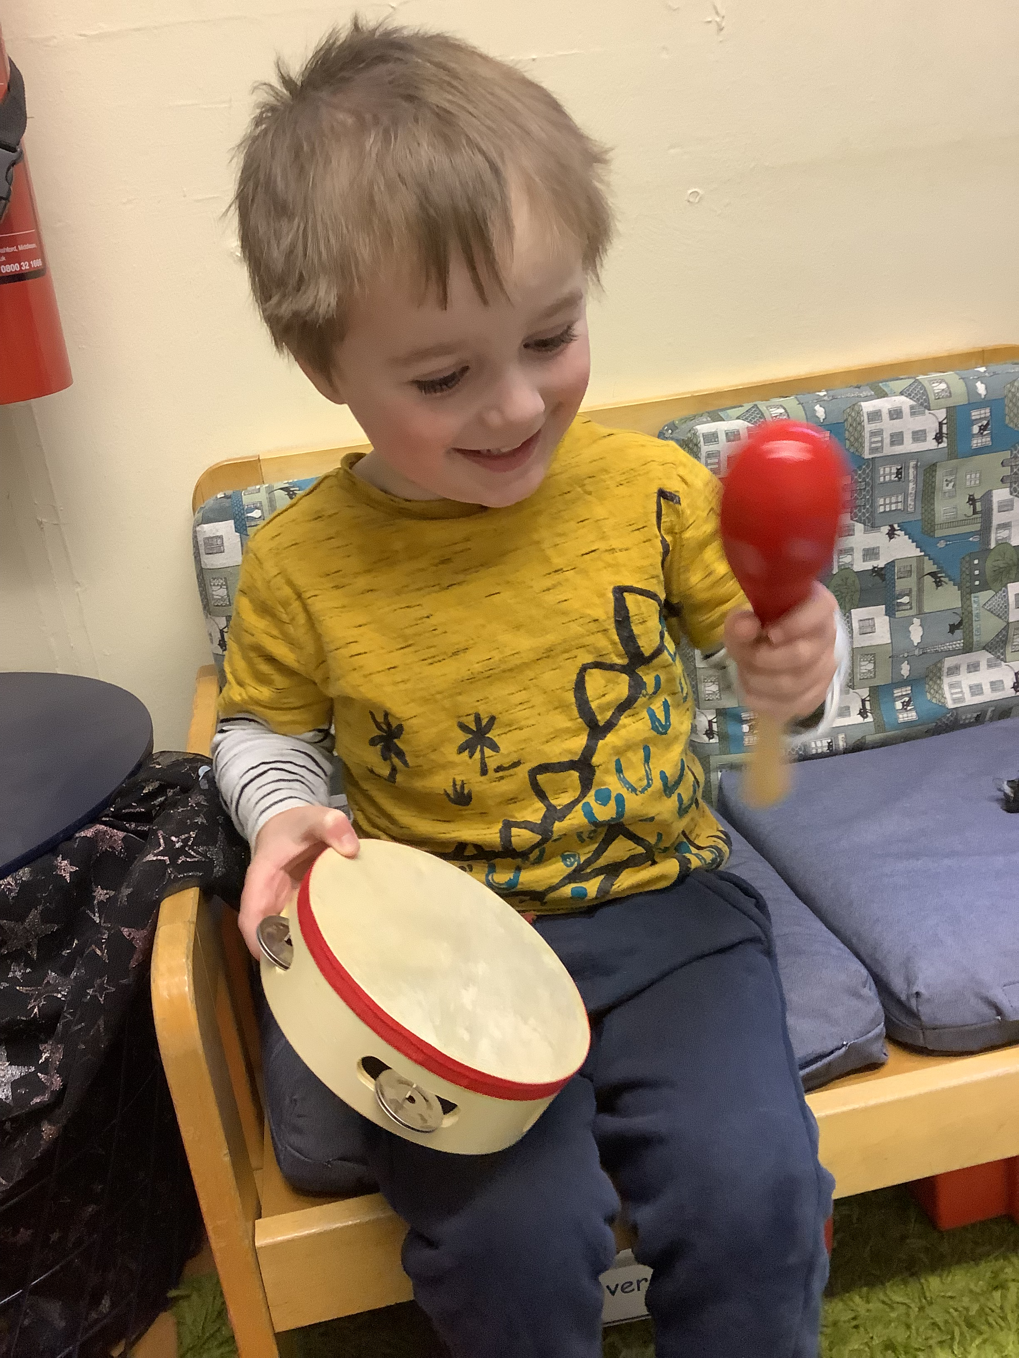
Musical Interaction develops…
Turn taking
Eye contact
Listening and attention skills
Speaking
Vocabulary (through action songs)
Requesting
Social Communication

Slide 8
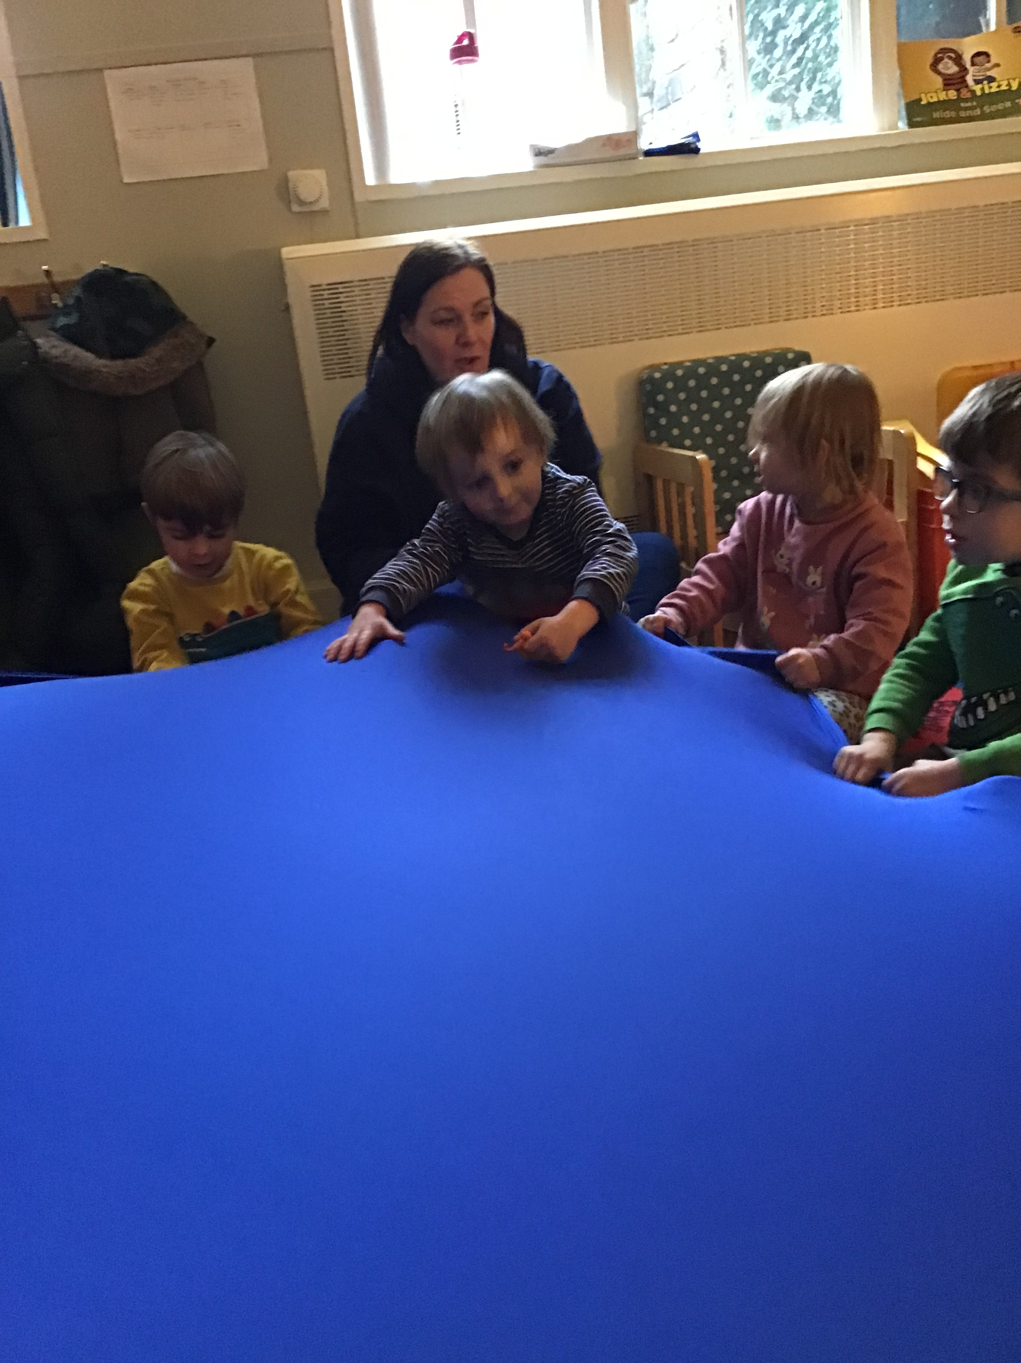
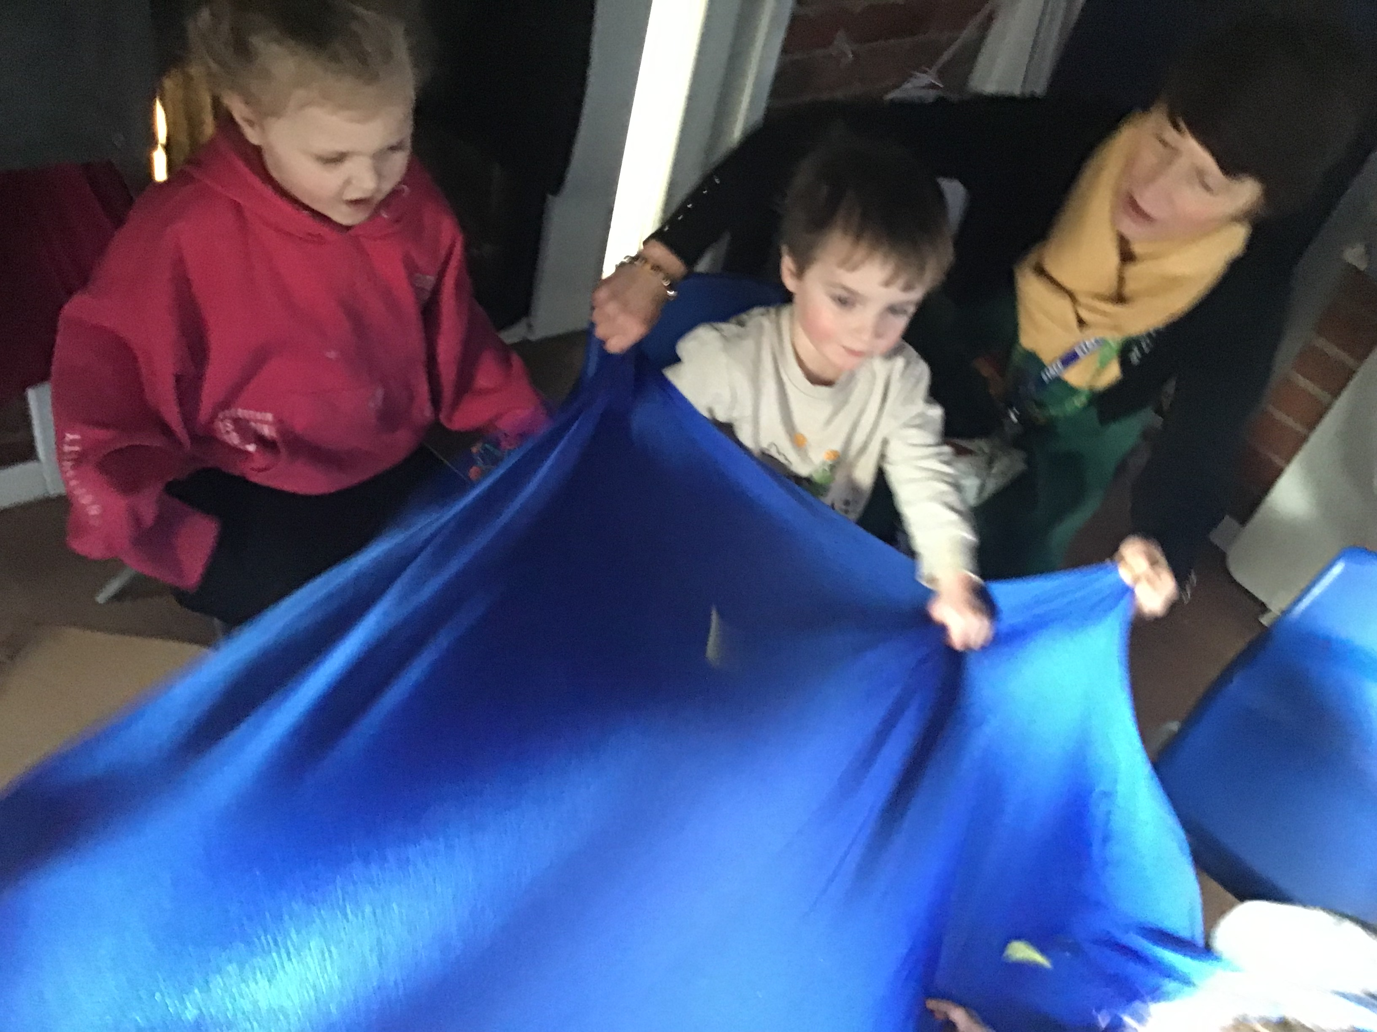
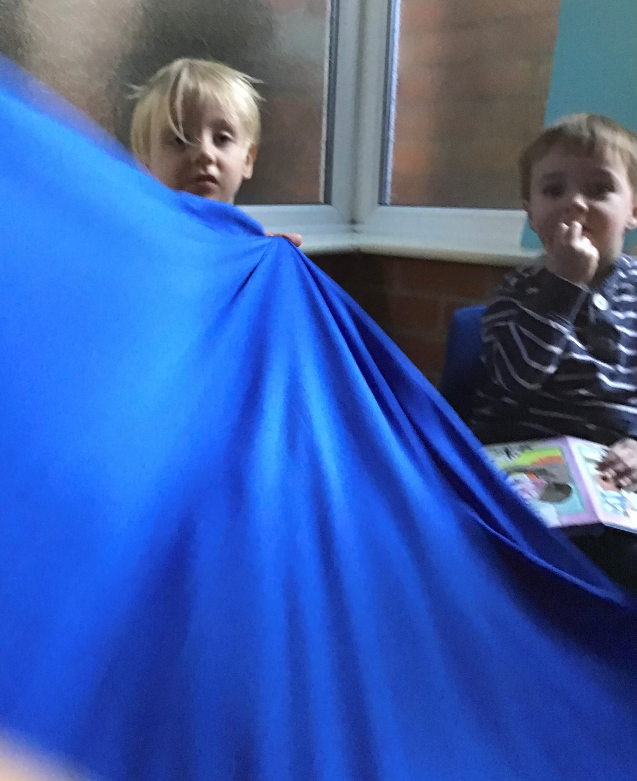
Lycra

Slide 9
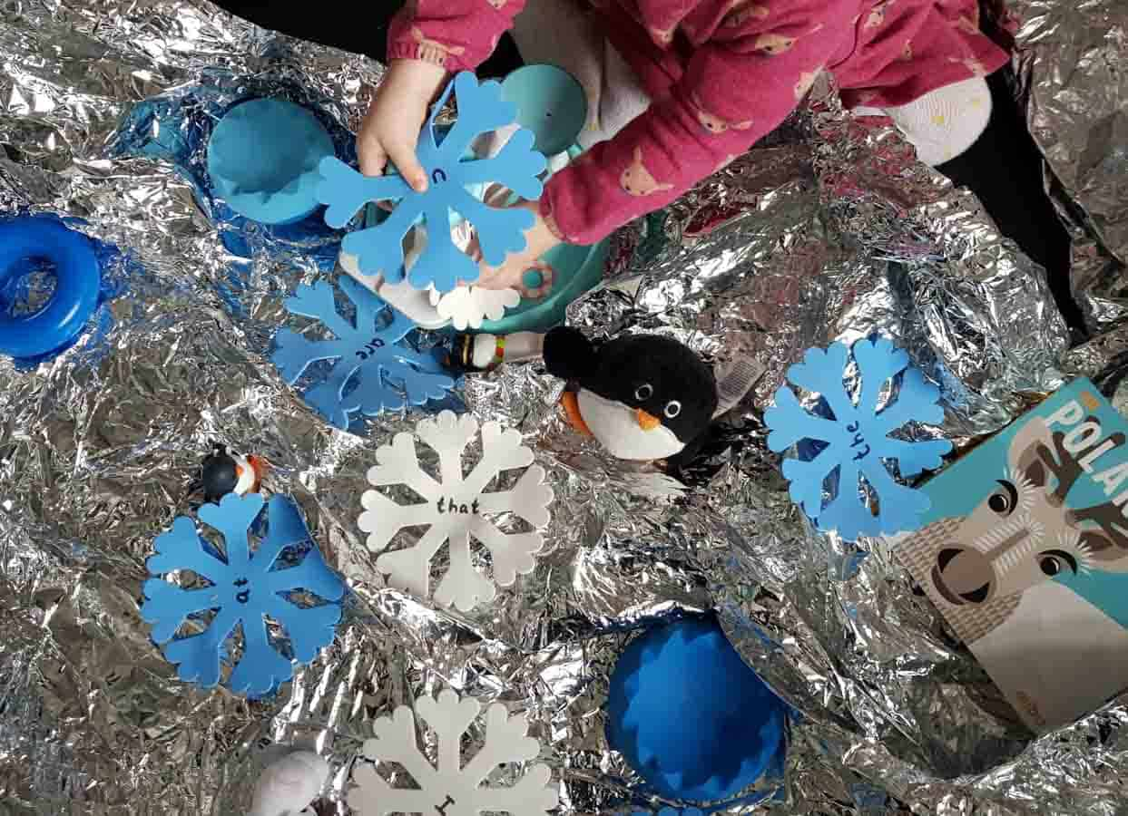
Tin foil blanket
Tin foil for group singing
Sprinkle with water and sing ‘I hear thunder’ or ‘It’s raining it’s pouring’
Shake it up and down and make rain inside!

Slide 10
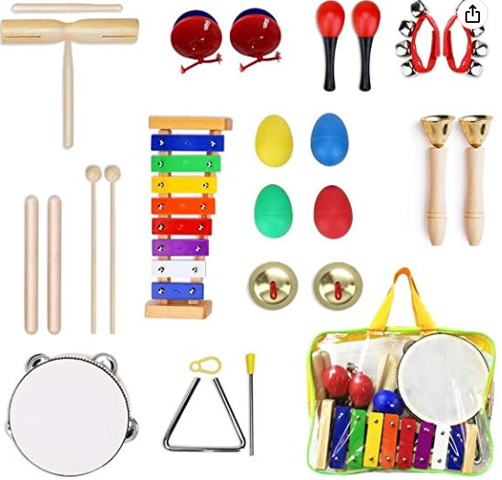

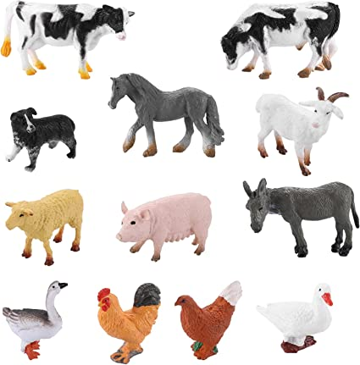

What’s in the bag?

Slide 11
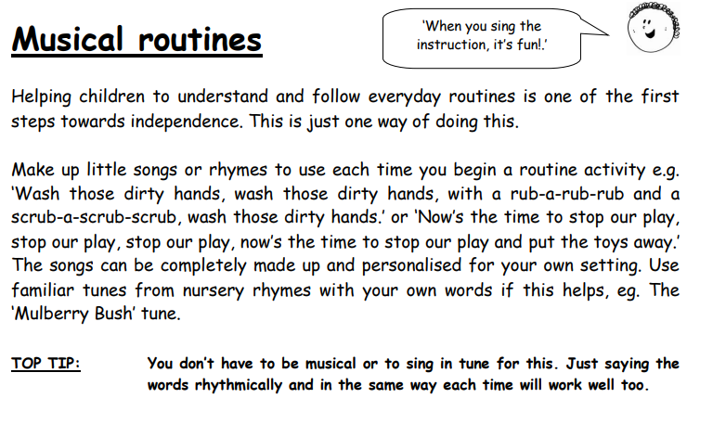
Musical Routines
Singing, whatever the time of day, the routine you are carrying out or whether you have a child learning to potty train, music can be used to support learning and interaction.

Slide 12
For requesting…
We use Colourful Semantics, as suggested by Speech and Language Therapists, to help children with requesting objects, activities or music. The small person in the video is requesting what to play on Alexa in our ERP.

Slide 13
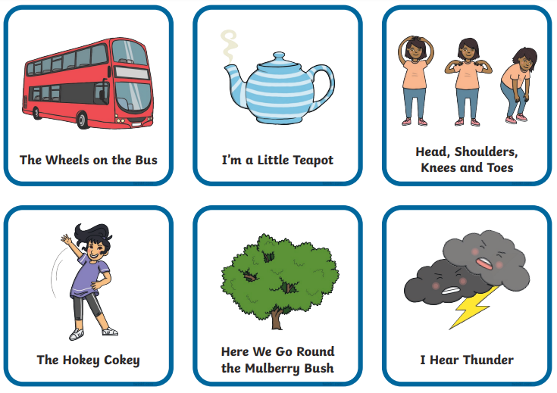
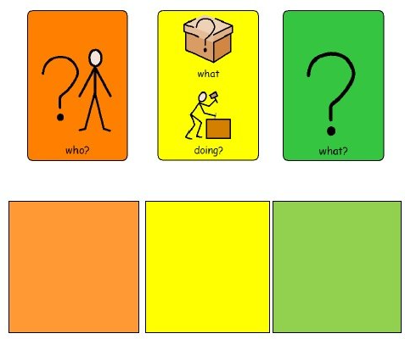
Choice boards…

Slide 14
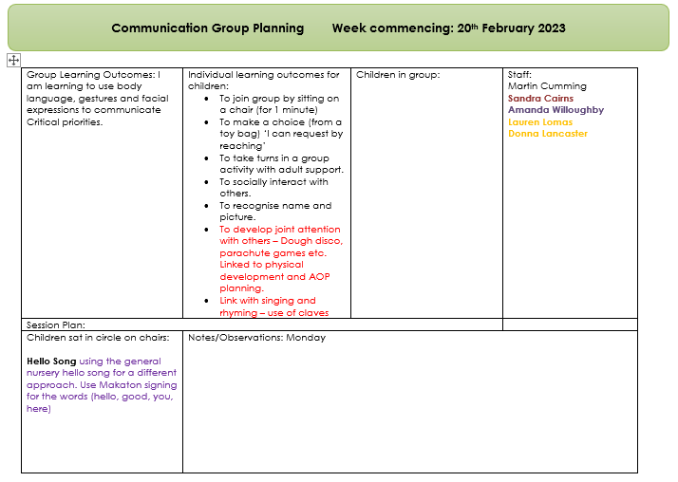
Communication
Group…
Used to develop social communication in children with SLCN. We do this daily following a set routine. We have found over the years that this is truly beneficial to building daily routine, interactions between peers but also between adults and children. We ensure that the activities are highly motivational and fun.

Slide 15

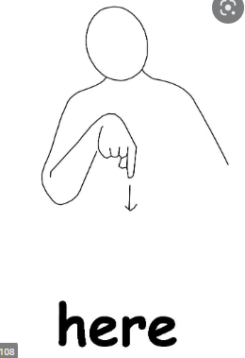

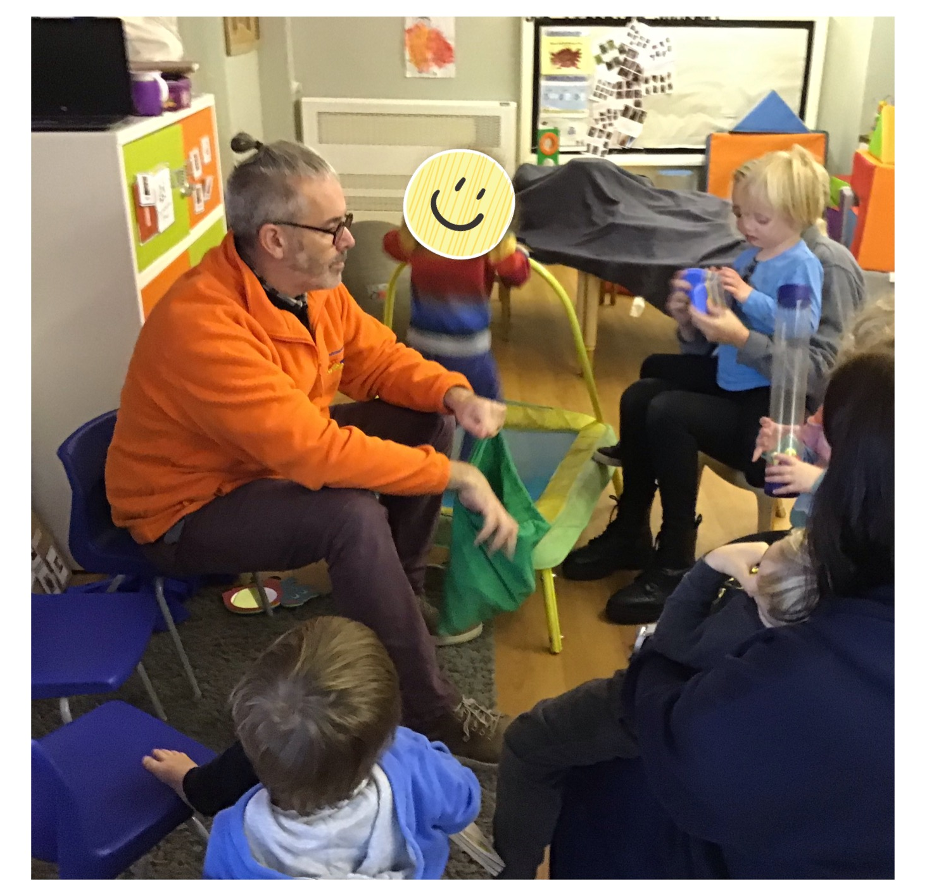
Communication Group – Typical Session…
Hello Song
Names – From a choice – use errorless learning
Choice Board/Instruments/Sensory Toys
Activity – such as wiggle, foil, lycra, parachute
Goodbye Song

Slide 16
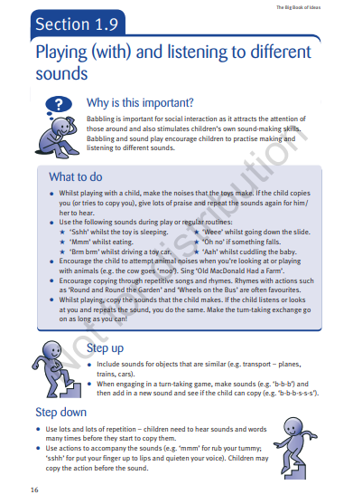
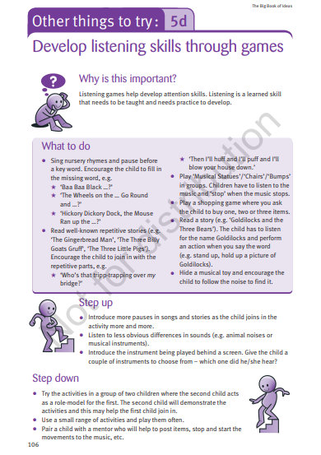
How it links to Wellcomm…
Links to Musical interaction/ Intensive Interaction
1.9
3.2
3.9
5d

Slide 17
Intensive Interaction
What is it?
It is a form of interaction between, for example, an adult and a child, which develops social communication skills. It is developed through a play based approach.
It is about making activities fun, making yourself a ‘desirable’ person to interact with.
It is also about knowing what activities the child finds motivational.

Slide 18
Main Aims of Intensive Interaction:
Developing eye contact
Facial expressions
Allowing others into your personal space
Learning to enjoy other people
Vocalising with meaning…not necessarily words but express intent
To understand why physical contact may be needed (Social cues)

Slide 19
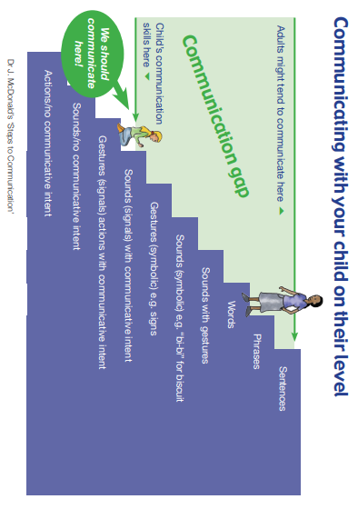
Closing the communication gap.
Bringing communication to the child’s level and building from there.
Taken from Leeds Community Healthcare – Intensive Interaction

Slide 20
What do we need to be careful of?
Some children, especially those who have or potentially have a diagnosis of Autism find eye contact very uncomfortable, and the aim of intensive interaction is to aid social communication rather than impede it.
Remember ‘child centred and child led’

Slide 21
Developing practice already in place…
As early years practitioners we already, intuitively follow some of the ideas of ‘Intensive Interaction.’ We get down on a child’s level, we respond to the cues that they give us and we try to develop their interaction through play. It is about honing this and pairing it back to a simpler level to develop in children with ASC or SLCN.

Slide 22

How do we get started?
Getting down on a child’s level is the first step.
Face to face, so the child can see your facial expressions.
Mirror facial expressions and noises that the child makes.
If the child is not engaging in interactions with you or walks away. Stop and attempt again at another time.
©About Autism

Slide 23
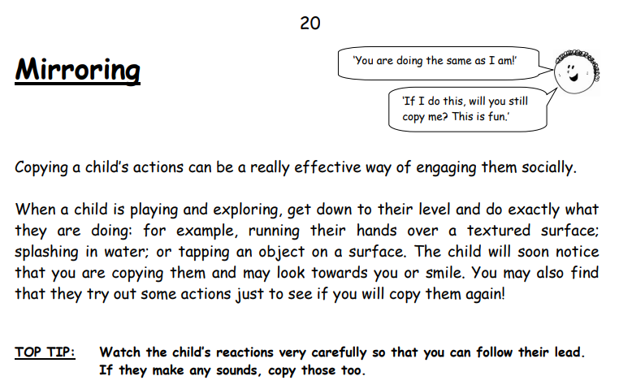
Communication Toolbox Cards…
Great place to start is with Mirroring.
Copying what a child is doing to engage them socially.
If they are choosing to do the activity this must be motivating for them.

Slide 24
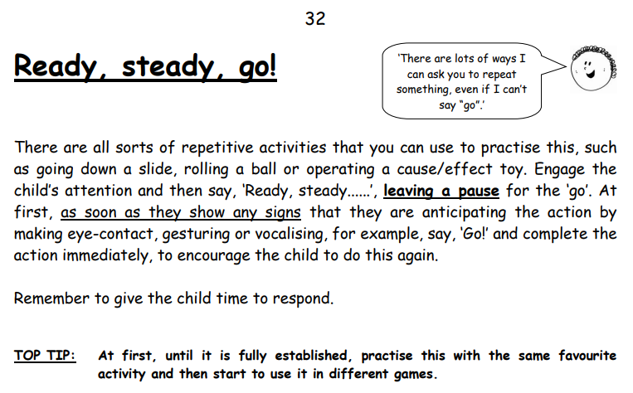
Communication Toolbox Cards…
Ready, Steady, Go!
Engaging in a highly motivating activity.
Reinforcing eye contact wit ‘good looking’
Leaving pause for communication before saying go.

Slide 25
Communication
Group… as intensive interaction
We use this as a group version of intensive interaction.
We are encouraging eye contact
Listening skills
Others in our personal space
Turn taking
Requesting
In a fun, nurturing environment – more adult led that child initiated.

Slide 26
Planning
In the moment
Using speech and language outcomes
Using Wellcomm
Communication Toolbox Cards
Communication Group Activities
Child led

Slide 27
Remember…
There is a time for child led and also adult initiated interaction.
Make yourself a desirable person to be with.
Keep it fun, interactive and focussed on the child’s interests.
If it isn’t working don’t force it…re-group, re-think and try again. (it may take a while to make some head way)
Jot down what has worked, although it may not a second time!
You have got this!! (As I say to my kids!!)

Slide 28
Useful Links:
Spread the Happiness
https://www.spreadthehappiness.co.uk/
Colourful Semantics Book
https://www.amazon.co.uk/s?k=colourful+semantics&crid=1RPZM81D8VNKS&sprefix=colourful+semantics%2Caps%2C82&ref=nb_sb_noss_1
Jabadao
https://www.jabadao.org/resources-lycra-and-elastic

