Slide 1
The Graduated Response
Part 2:
Do and Review
Thursday 2nd March 2023
9 – 10.30am via Teams

Slide 2

Housekeeping
Remain confidential
Listen to each others perspective
Microphones on silent to reduce background noise
Please contribute to the discussions ☺
If you have any questions as we go please feel free to put them in the chat.

Slide 3
Session Overview
Recap on the Graduated Approach
Identifying how to complete the ‘do’ part of the approach.
Supporting practitioners to prepare for the ‘review’ part of the graduated response.

Slide 4
Assess
What are the needs of the child?
Plan
Do
Plan into daily timetables
Review
How will we find out what they need?
How do we know?
How did it go?
How do you know?
Review meeting?
Who do you invite?
Engage parents and involve them in delivery
Gather and record progress.
Adapt as needed
What tools will we use? Statutory or non statutory?
How do we record the families voice?
The child’s voice?
What kind of plan is needed? MAO or MSP?
Who will support?
What?
How often?
Targeted support?
Specific intervention?
Apply for EYIF?
The Graduated Response…

Slide 5
Do
The SEN Code of practice states…
‘The early years practitioner, usually the child’s key person, remains responsible for working with the child on a daily basis. With support from the SENCO, they should oversee the implementation of the interventions or programmes agreed as part of SEN support. The SENCO should support the practitioner in assessing the child’s response to the action taken, in problem solving and advising on the effective implementation of support.’
SEN Code of Practice (2015) Section 5.42 page 87
  Plan into daily timetables
  Engage parents and involve them in delivery
  Gather and record progress.
  Adapt as needed
Notes:
SENCO to support Practitioner remains the child’s key person.

Slide 6
Key aspects of ‘Do’
How do we meet a child’s learning needs?
How do we teach? (Areas of provision, group work, 1:1)
Who supports?
What reasonable adjustments can we put into place?
How do we know what we are doing is making a difference?
How can we measure and record progress?
What strategies can we use to help support learning?

Slide 7
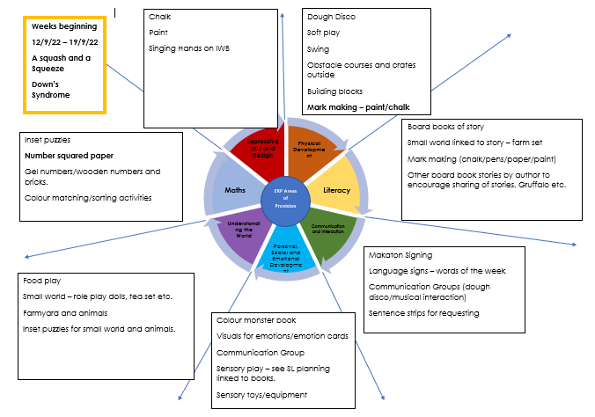
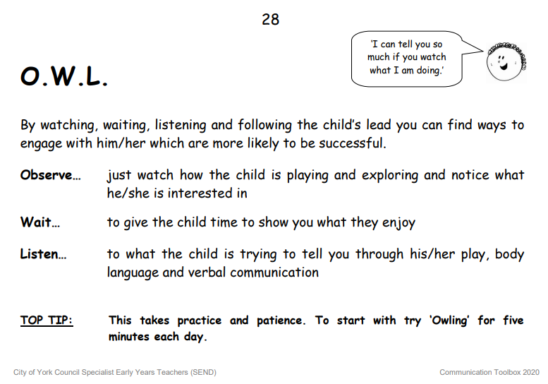
How do we meet a child’s learning needs?
We observe, we assess, we plan and then we ‘teach’ the do part of the cycle.
Observation is key in the early years and we observe through everything that we do…but sometimes we need to some support in this. Two ways in which we do this are PLOD and O.W.L.
Know what motivates your children…

Slide 8

Who supports?
Myth – A child with additional needs always needs1:1 support.
We don’t need 'Velcro Vera’s' we need targeted support.
Children should be best supported by those who can move there learning forward. A person that the child finds highly desirable, motivational and nurturing. Who is often the person that they have formed their secure base with.
Just because a child has an MSP does not mean that they need someone permanently attached to them. Children in the early years may need support but they also need the freedom and opportunity to explore their learning environment and to learn through exploration.
Notes:
There are of course times that some children need, for safety reasons, someone supporting, however this can be done in different ways.

Slide 9

‘The focus of any person supporting a child with SEND is…supporting the child to thrive and ensuring that the child develops independence and life skills. If a child becomes entirely dependent on us, we are not supporting a healthy pattern of attachment. One piece of the key pieces of advice that I give practitioners is that if they insist on referring to one-to-one, thy must also clearly outline what that person will do to support learning and development’
Kerry Murphy ‘A guide to SEND in the Early Years’

Slide 10
What reasonable adjustments can we put into place?
Supporting a child with an MSP or EHCP may mean that you need to make reasonable adjustments within your setting.
Kerry Murphy suggests that the first starting point for this is our own mindset and how we are willing to consider changes in our own practice.
We have a duty under the Equality Act (2010) and the Code of Practice (2014) to help support children to access their learning environments.
Reasonable adjustments don’t mean that you must change your building or setting, it may just mean that a child needs to be met at the door by their key worker in the morning, or you may need to source specialist seating for a child to sit at when they are eating dinner.
It may mean that we have to be a little more flexible with how we teach.

Slide 11
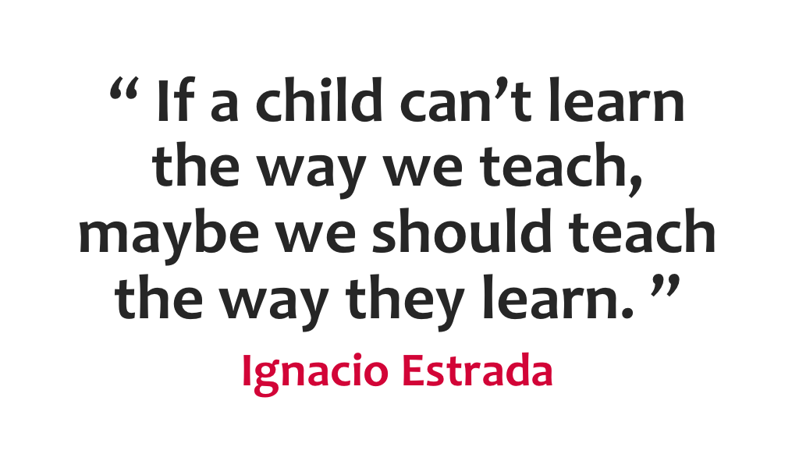

Slide 12
How do we teach? (Areas of provision, group work, 1:1)
Areas of Provision
Group Work
1:1
Teaching the children where they are playing or accessing provision.
Interests led (if they like dinosaurs use dinosaurs etc)
May then be able to involve their peers as well...encouraging social communication.
Teaching as part of a small group…shared learning needs or outcomes.
Part of a specific intervention.
May need to teach this in an area away from main setting.
Specific work on learning outcomes.
SALT targets
Communication and Interaction etc. Depending on MSP/EHCP outcomes.

Slide 13
How do we know what we are doing is making a difference?
As part of setting learning outcomes we ensure that we can ‘measure’ the progress that the child is making.
Specific
Measurable
Achievable
Realistic
Time bound
This does not always need to be physical evidence – such as the information that we may get from a Wellcomm Assessment e.g. Alice has made two levels progress and is answering 5 questions correctly. (Although this is good evidence for next steps) It could be in the form of photographs, videos or just noting down anything new that you have observed when working with the individual.

Slide 14


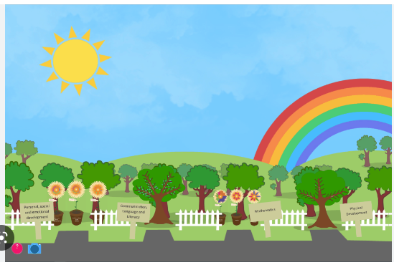





How can we measure and record progress?
Notes:
Other interventions that we may put in like Early Talk Boost etc.

Slide 15
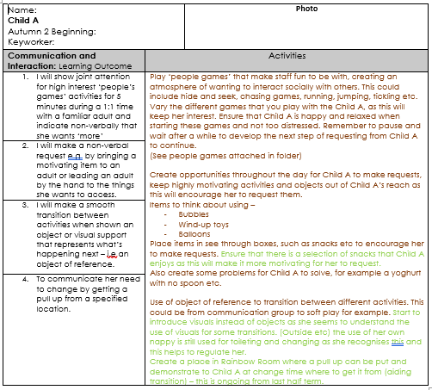
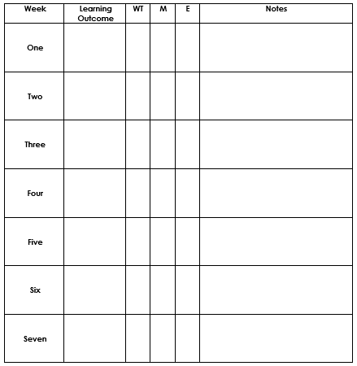
How can we measure and record progress?

Slide 16
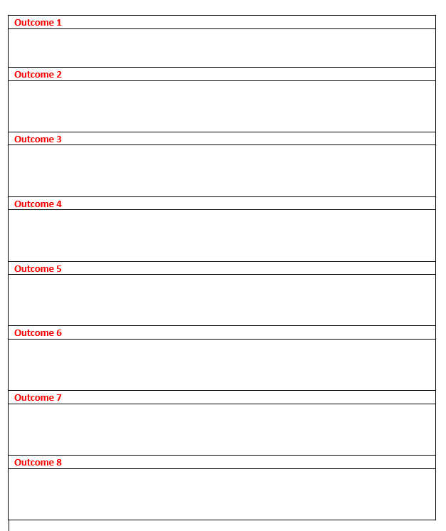
Observations sheet –
Write the outcomes down and then keep a note of when you have observed something towards achieving that outcome.
Write notes of when you have worked with the individual child.

Slide 17
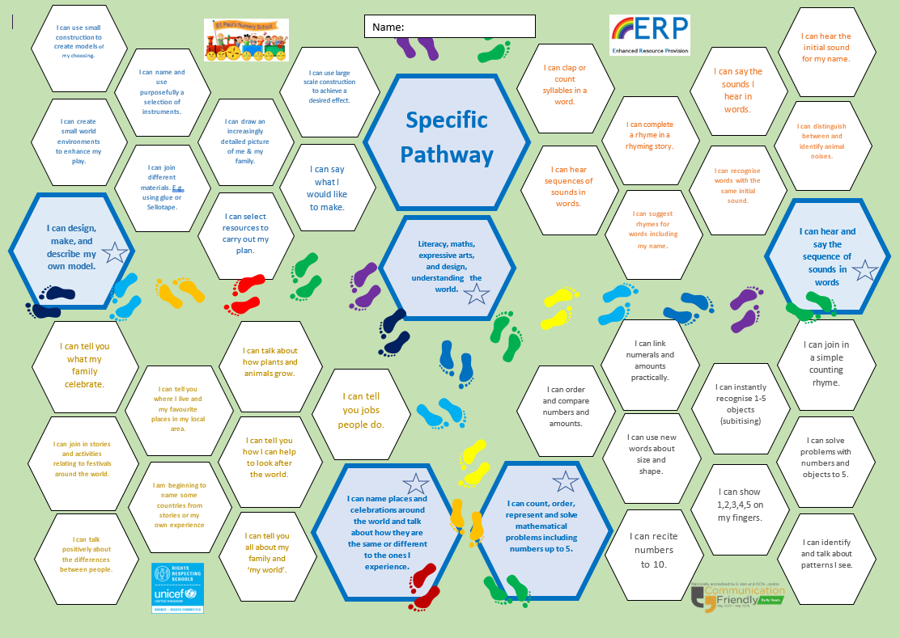
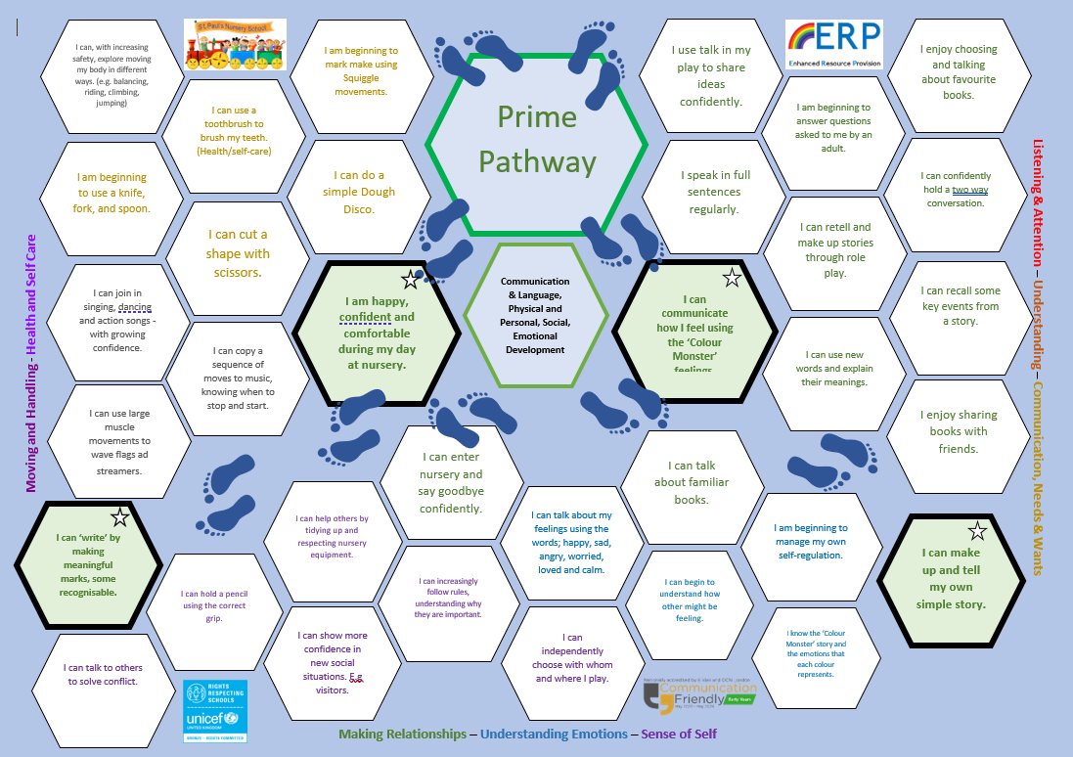
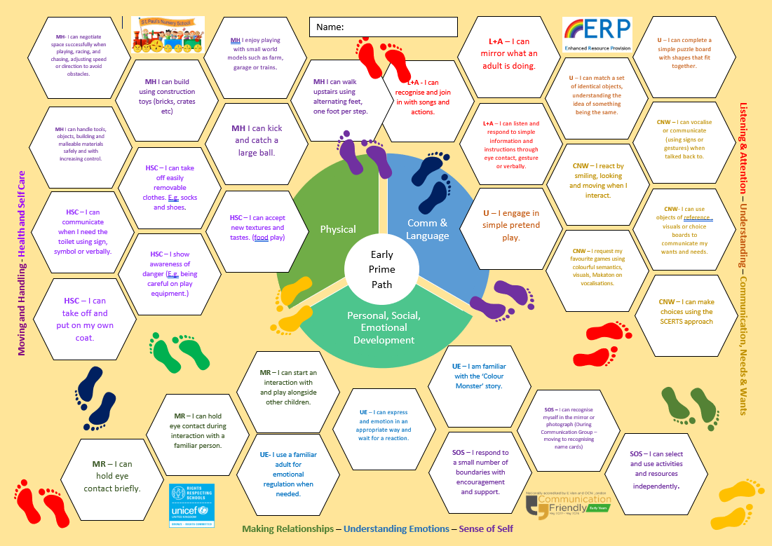
Use your own curriculum plan
Ticking and dating when you have observed on three occasions.

Slide 18
What strategies can we use to help support learning?
A.O.P. / Whole Setting
Group Work
1:1

Slide 19
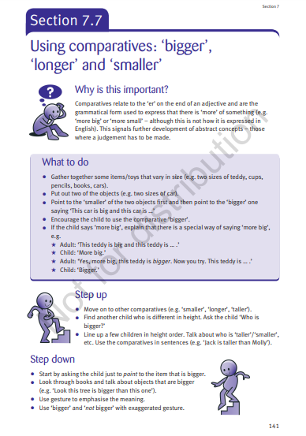
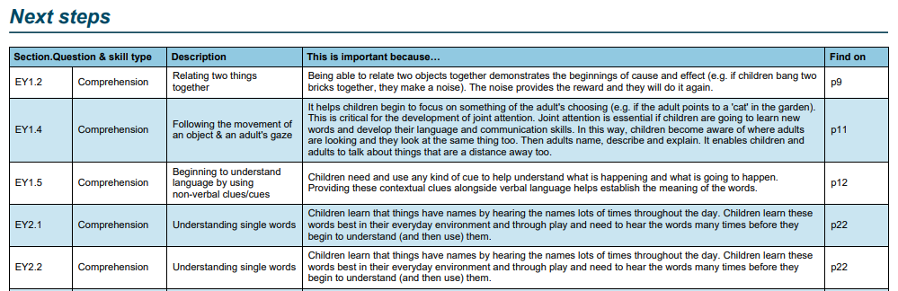
Using the Wellcomm Assessment to plan next steps in learning.
Wellcomm Wizard can be used to look at the next steps that are needed for the individual child or can be used to plan for a group.
We use Wellcomm Wizard / assessments to look at the ‘best fit’ for a group - differentiated for each group.

Slide 20
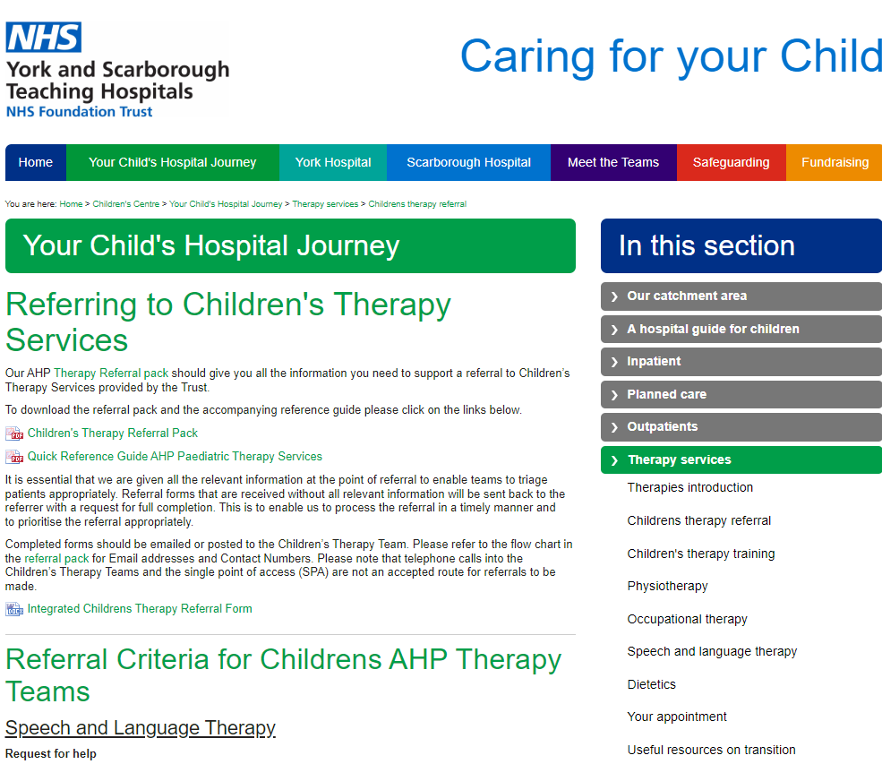
Episode Care Plan
Speech and Language therapist episode care plans have suggested way to help support children’s SLT outcomes.

Slide 21
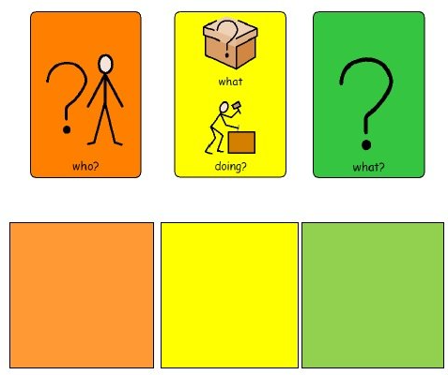

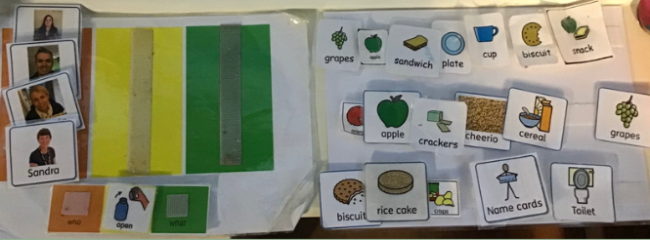

Slide 22

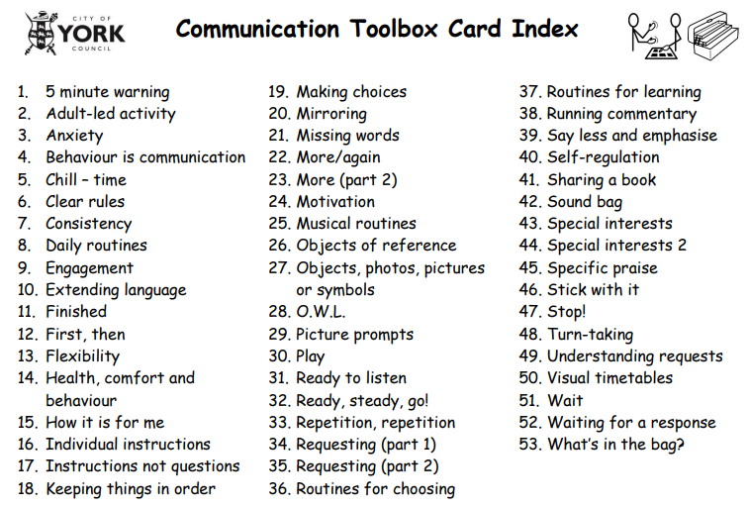
Great strategies to help support learning.

Slide 23
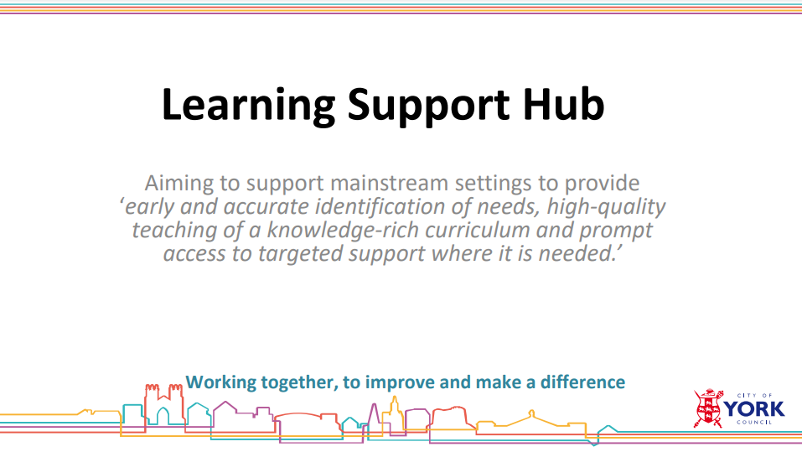
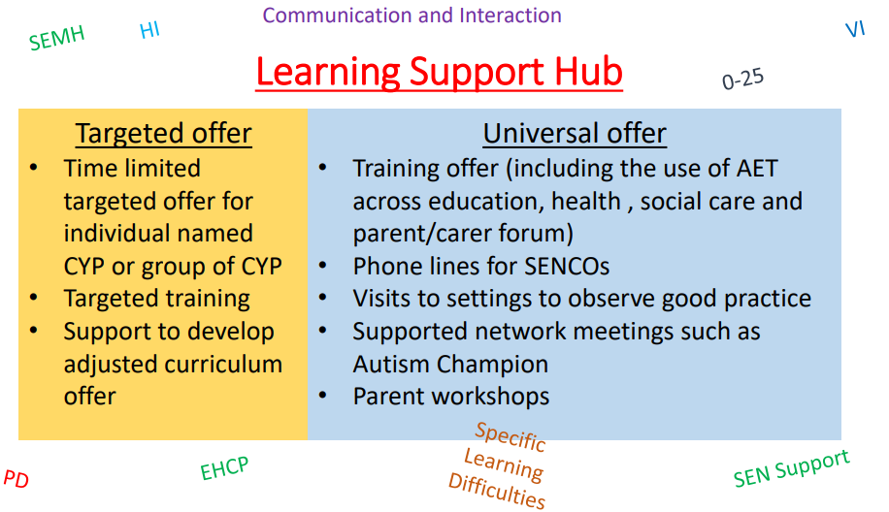
Help and support is available through the Learning Support Hub
Phone call on a Friday afternoon can be arranged through
www.koalendar.com/e/eysupport.
Or you can make a request for targeted support.

Slide 24
Review
The code of practice states…
‘The effectiveness of the support and its impact on the child’s progress should be reviewed in line with the agreed date. The impact and quality of the support should be evaluated by the practitioner and the SENCO working with the child’s parents and taking into account the child’s views. They should agree any changes to the outcomes and support for the child in light of the child’s progress and development.
Parents should have clear information about the impact of the support provided and be involved in planning next steps.’
SEN Code of Practice (2015) Section 5.43 page 87
  How did it go?
  How do you know?
  Review meeting?
  Who do you invite?
  What next?
  Do we need to increase the support through RSA/EHCNA
Notes:
Child first with support from parents.

Slide 25
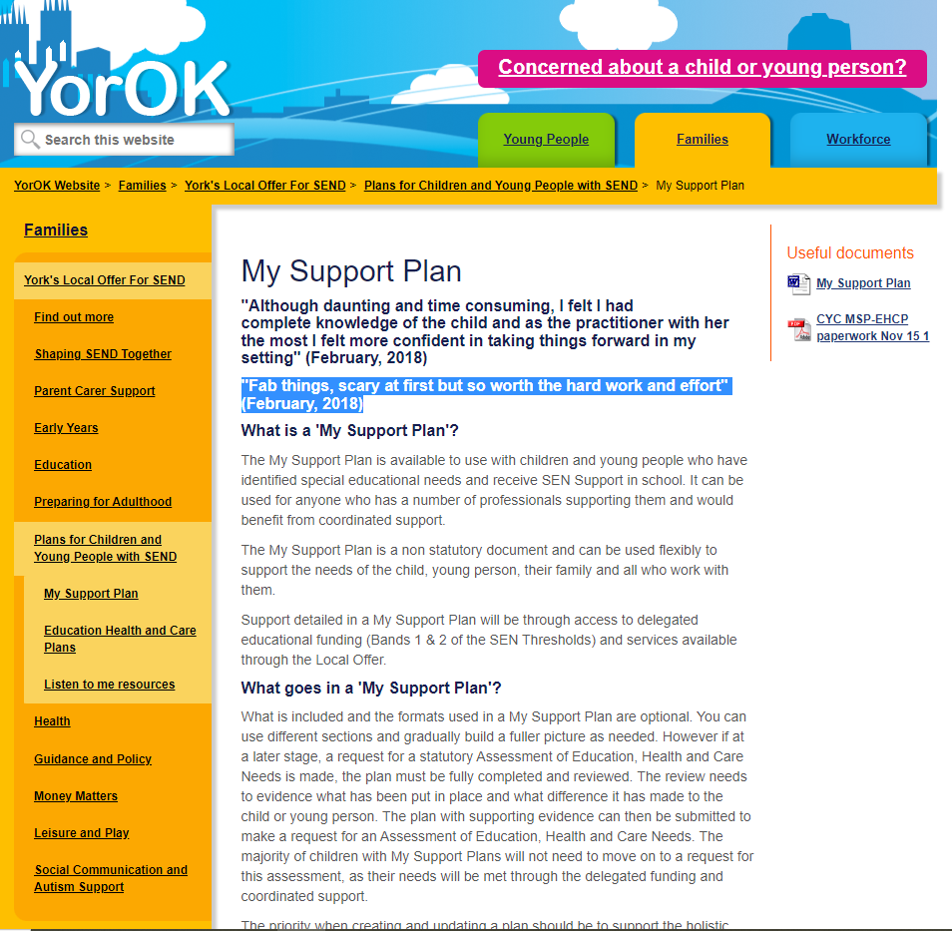
"Fab things, scary at first but so worth the hard work and effort" (February, 2018)

Slide 26
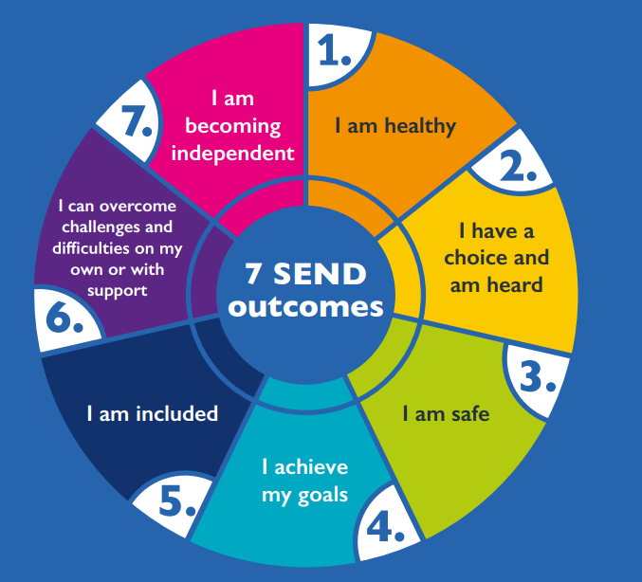
At the forefront of our minds -York Outcomes Framework
We want all children and young people in York with special educational needs and disabilities (SEND) to be happy and live the best lives they can. Young people, parents and carers have told us that the most important outcomes that all children and young people with SEND should achieve are:

Slide 27

Review
Talking Point…
How often should we review?
A) MSP
B) EHCP
Who should we invite to reviews?

Slide 28
Review
MSP
Set a date – well in advance (can be set at previous meeting)
Send invites
Information Gather
Send out paperwork – pre meeting
Hold review – using the MSP as your meeting agenda
Complete paperwork
Send copy to those who have attended meeting
If at the meeting the plan is to proceed for RSA/EHCNA complete paperwork and send to the local Authority

Slide 29
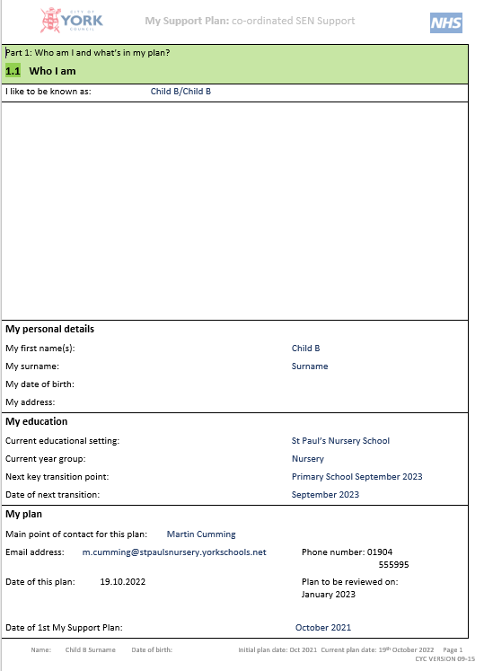
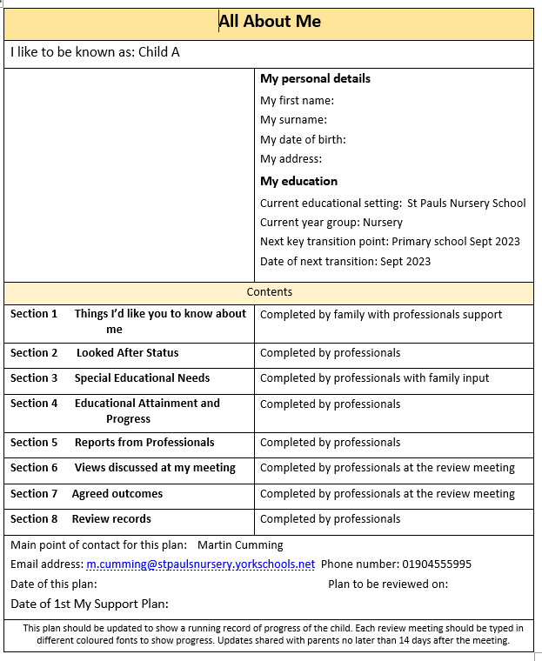
Two types of MSP suitable for Early Years

Slide 30
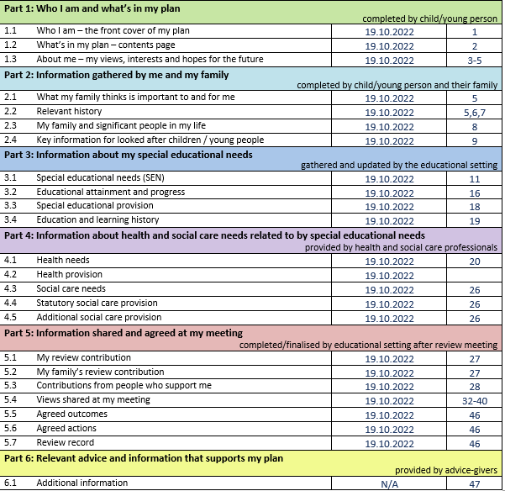
Update the relevant sections of the MSP pre meeting.
This helps keeping the paperwork manageable.
Top tip: Leave the page numbers until the end!

Slide 31
Contents page for the alternative version that is suitable for the early years.

Slide 32
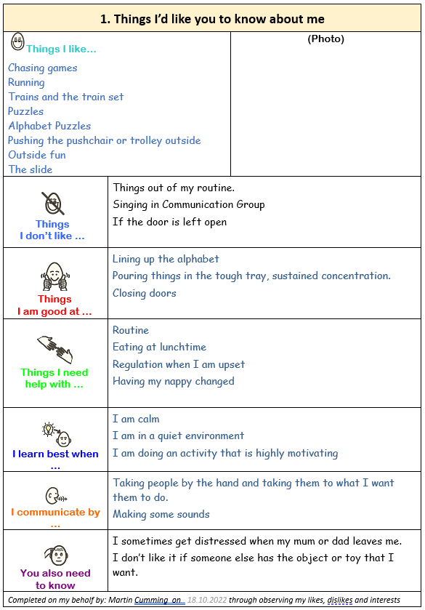
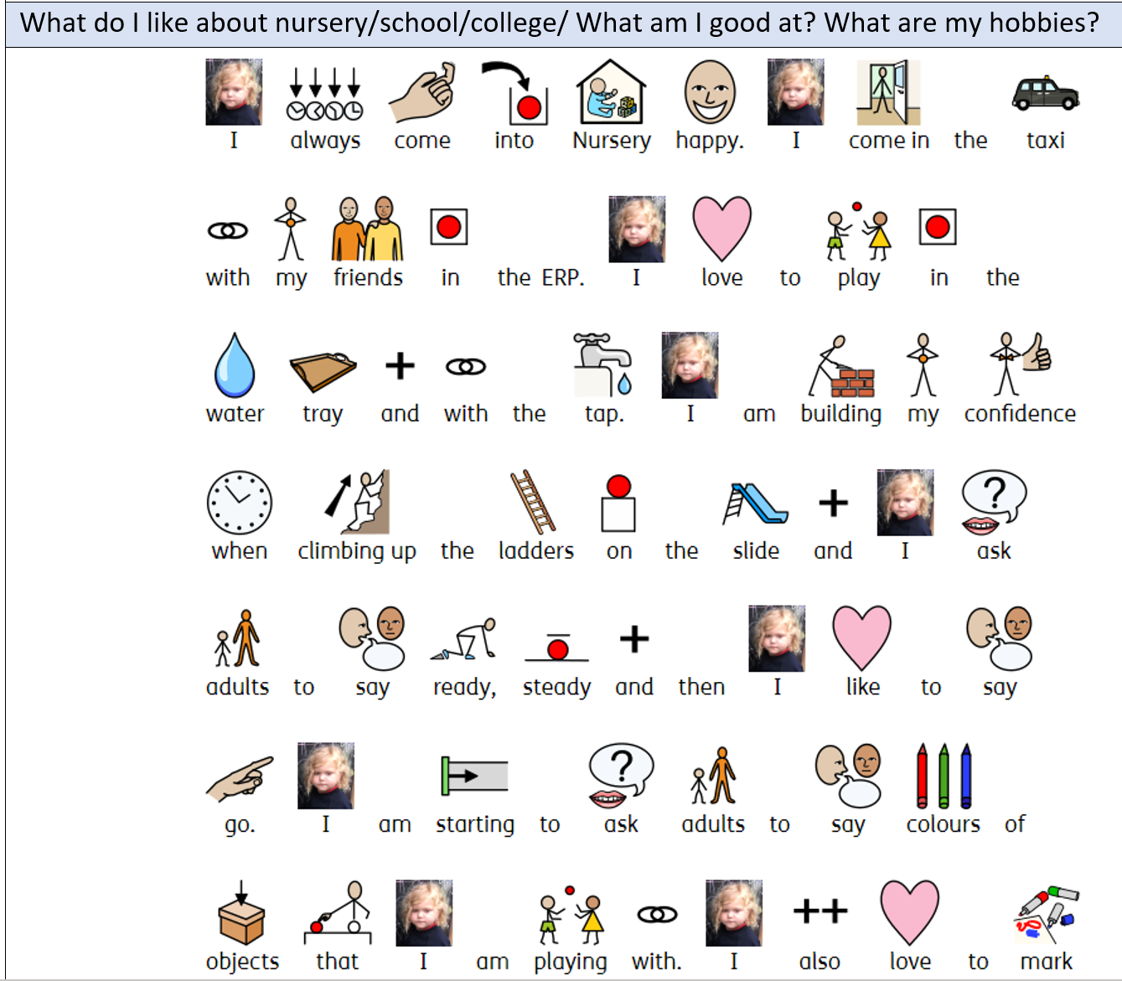
With children in the early years, especially those with communication differences it can be tricky to get their own review contribution.
Try using the TILYKAM and also photographs.
A picture paints a thousand words…
This can be done through:
Observation
Talking to key workers
Talking to parents

Slide 33
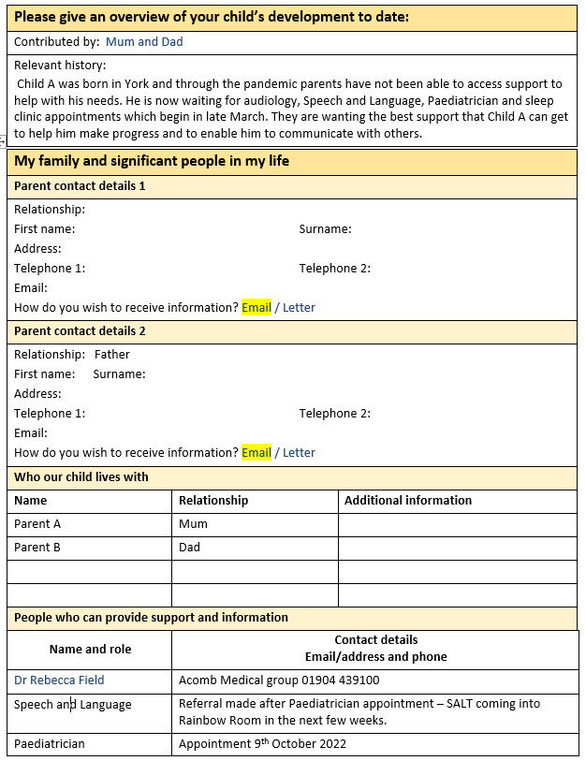
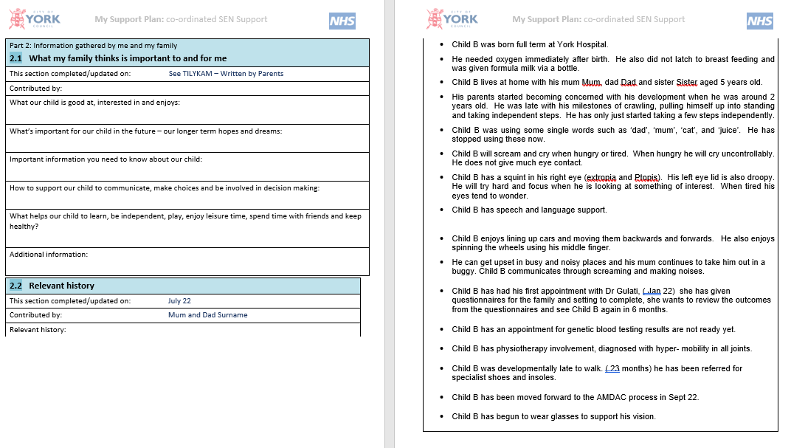
Pre meeting send the paperwork to parents/carers for them to update any relevant information.
I find it easier to highlight the sections that you want them to fill in.
Be mindful of parents needs as well, some may need support with accessing this.

Slide 34
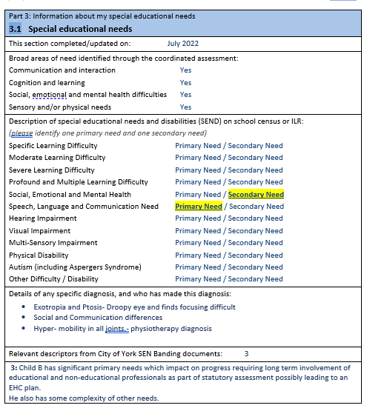
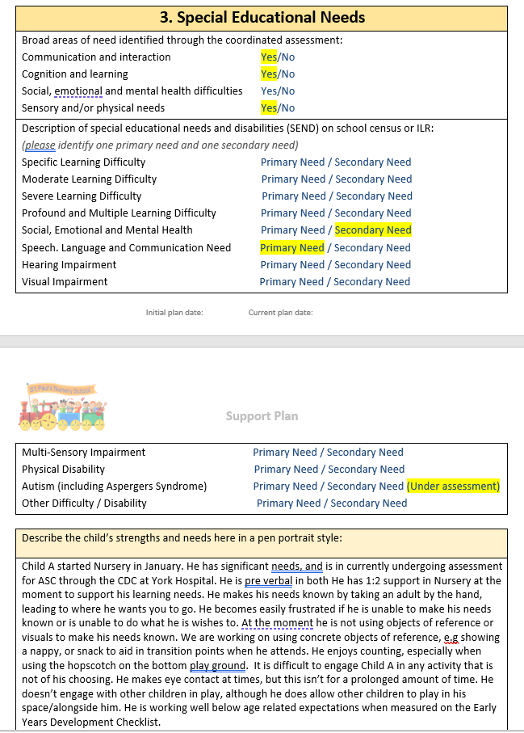
Outline any changes in SEN and describe the child’s strengths and needs. (Think about the narrative)

Slide 35
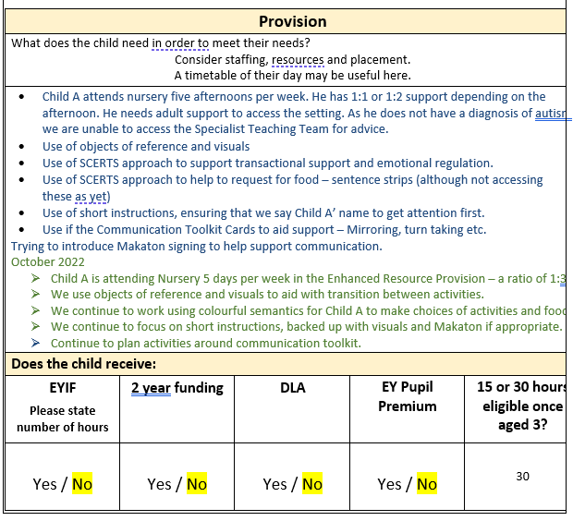
Describe the provision that is in place for the CYP.
Top tip: As a My Support Plan is a running record of support. Use a different colour for review. You can then see what had changed over time.

Slide 36
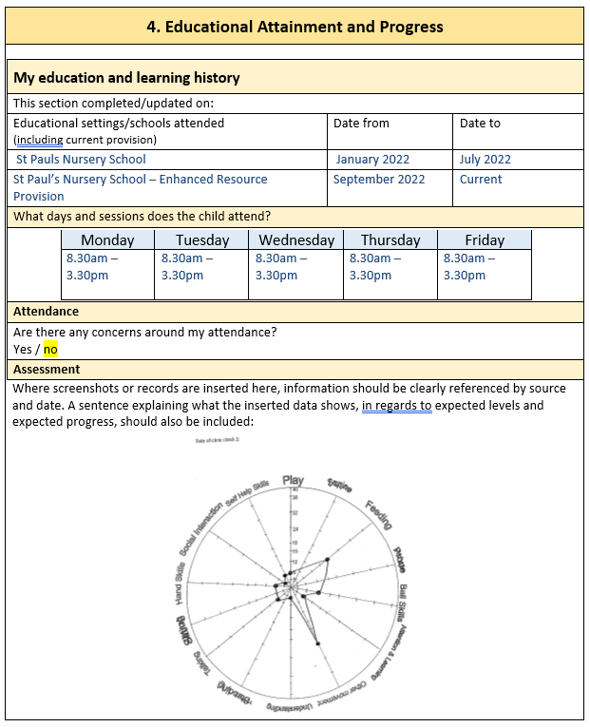
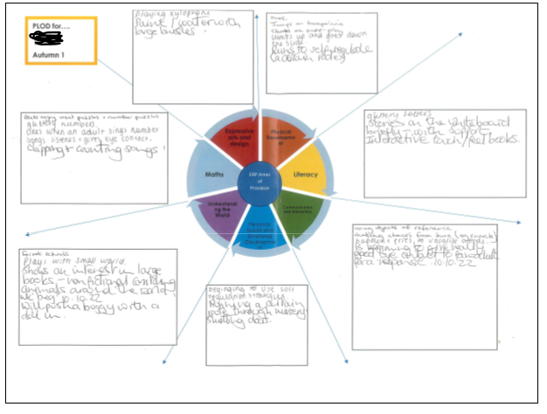
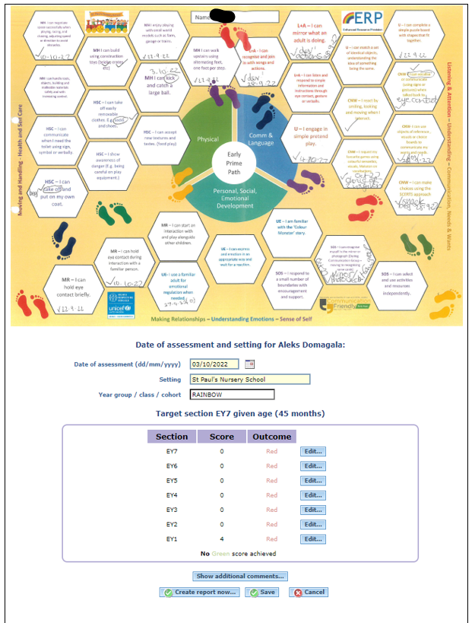
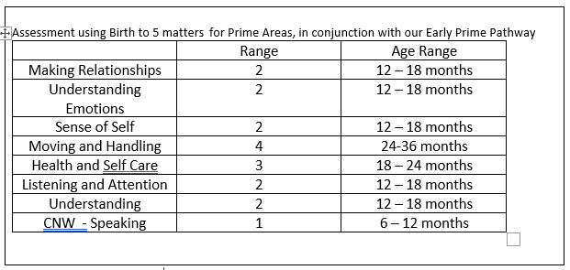
Update attainment…show the progress that the child has made.

Slide 37
Add in reports from professionals…
For a My Support Plan Review – attach any information that you and parents feel is relevant. This can be in the form of reports from professionals or in the case of SLT you can attach the episode care plan. The targets from an episode care plan can be used as learning outcomes for communication and interaction.
For an EHCP review you can ask professionals for specific advice for the relevant section of the paperwork. This can be attached with review paperwork.
Try to give professionals enough time to send in contributions.

Slide 38
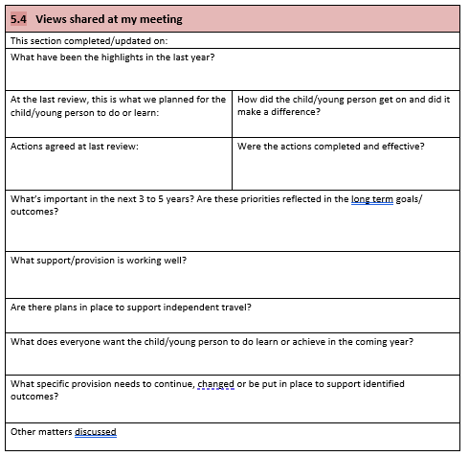
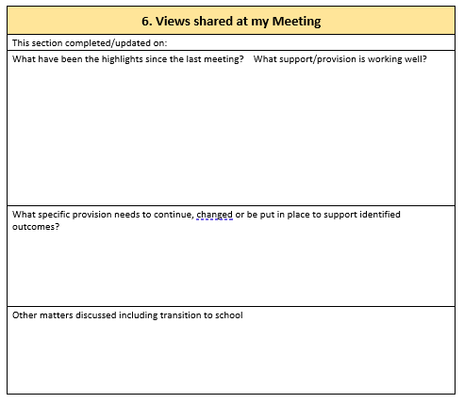
The review meeting…
Use section 5.4 of the LA MSP as the agenda for the meeting.
Or Section 6 of the St Paul’s proforma – this includes a section on transition to school or you could use this for transition to a different room

Slide 39
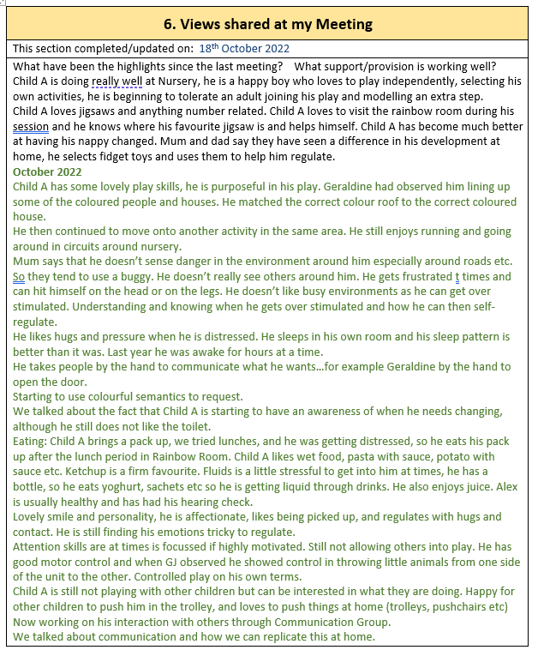
If you use different font colours for each review it is possible to see at a glance the information that is shared.

Slide 40

If at all possible have two members of staff in the meeting.
One to chair the meeting and the other to type up the paperwork as you go.
This not only saves time but also allows the chair to not have to worry about writing up as you go and can focus on the listening and talking. Especially if there are sensitive issues that need to be covered.
The chair can be the listening ear.
Top Tip

Slide 41

Remember the review is a celebration of the child’s achievements in nursery.
Try to focus on the positive and not on the negative narrative.
A Celebratory Approach (Pen Green Nursery) – what the child can do not what they can’t do.

Slide 42
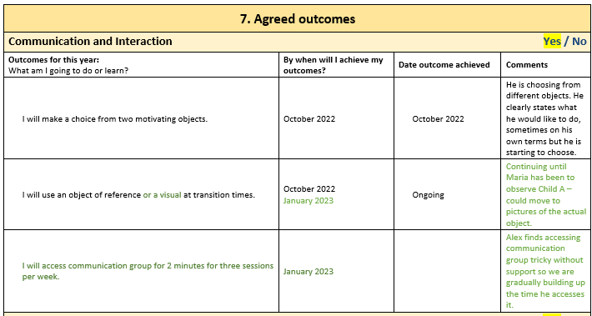
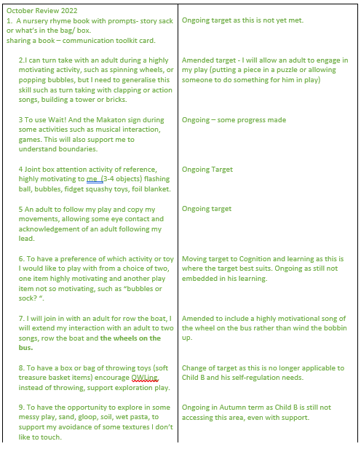
Review Outcomes…
Have they been met?
How do we know?
Are they still relevant?
Do we need to set new outcomes? (SMART)
Think about the broad areas of need…and the York Outcomes Framework

Slide 43
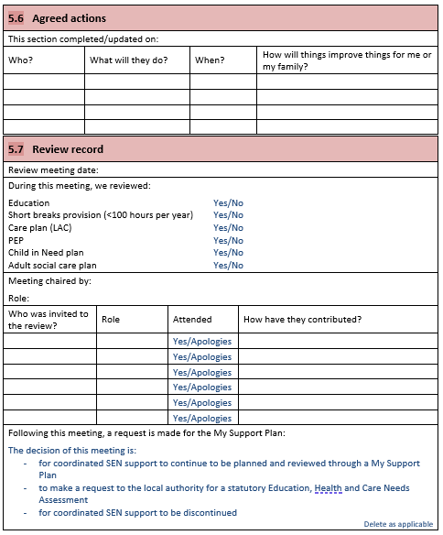
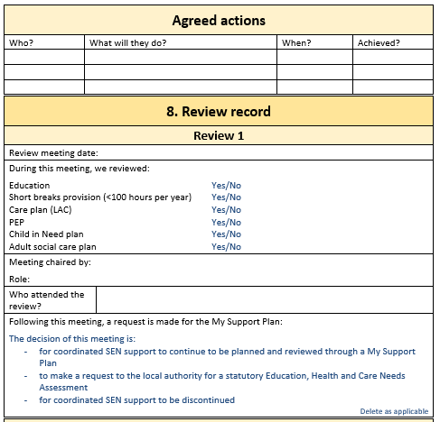
Complete the agreed actions and review records sections.

Slide 44
Remember next steps…
MSP to continue
Make a request for RSA/EHCNA
SEN Support Discontinued

Slide 45
Discussion point:
How do we know when to put in a request for statutory assessment (RSA) or Education Health and Care Needs Assessment (EHCNA)?

