Slide 1
The Graduated Response part 1:
Assess and plan
Tuesday 21st February 2023
1 – 2:30 via Teams

Slide 2

Housekeeping
Remain confidential
Listen to each others perspective
Microphones on silent to reduce background noise
Please contribute to the discussions ☺

Slide 3
Session Overview
Explaining the Graduated Approach
Identifying how to complete the ‘assess’ part of the approach.
Supporting practitioners to prepare for the ‘plan’ part.

Slide 4
What the Law says – a definition of Special Educational Needs (SEN)
The Children and Families Act 2014 (Section 3 Para 20)
A child under compulsory school age has a learning difficulty or disability if he or she is likely to be within subsection (2) when of compulsory school age (or would be likely, if no special educational provision were made).
A child or young person does not have a learning difficulty or disability solely because the language (or form of language) in which he or she is or will be taught is different from a language (or form of language) which is or has been spoken at home.

Slide 5
The SEN Code of Practice (p79) states:
All those who work with young children should be alert to emerging difficulties and respond early. In particular, parents know their children best and it is important that all practitioners listen and understand when parents express concerns about their child’s development. They should also listen to and address any concerns raised by children themselves.
Early years providers must provide information for parents on how they support children with SEN and disabilities, and should regularly review and evaluate the quality and breadth of the support they offer or can access for children with SEN or disabilities.

Slide 6
The Graduated Response – An Overview
Where a child/young person is identified as having Special Educational Needs, educational establishments should take action to remove barriers to learning and put effective special educational provision in place. This is called SEN support and should take the form of a four-part cycle through which earlier decisions and actions are revisited, refined and revised with a growing understanding of the child / young person’s needs and of what support the child/young person needs to secure good progress and good outcomes.
This is known as the Graduated Response. It draws on more detailed approaches, more frequent reviews and increasingly specialist expertise in successive cycles in order to match interventions to the SEN of children and young people. (CoP Para 6.44)

Slide 7
The graduated approach can encompass an array of strategies which are underpinned by a number of central principles:
All children/young people are entitled to high-quality everyday personalised teaching;
All children/young people can learn and make progress;
All teachers are teachers of SEND;
A differentiated curriculum is not SEND provision - differentiated learning opportunities should be given to all learners;
Provision for a child/young person with SEND should match the nature of their needs;
There should be regular recording of a child’s / young person’s SEND, of the planned outcomes, of the action that the setting is taking, and of impact of those actions and the outcomes achieved.

Slide 8
Assess
What are the needs of the child?
Plan
Do
Plan into daily timetables
Review
How will we find out what they need?
How do we know?
How did it go?
How do you know?
Review meeting?
Who do you invite?
Engage parents and involve them in delivery
Gather and record progress.
Adapt as needed
What tools will we use? Statutory or non statutory?
How do we record the families voice?
The child’s voice?
What kind of plan is needed? MAO or MSP?
Who will support?
What?
How often?
Targeted support?
Specific intervention?
Apply for EYIF?

Slide 9
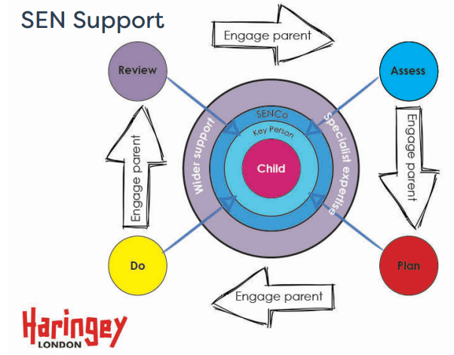

Slide 10

The Graduated Response –
The Corkscrew...

Slide 11

Why a corkscrew?
See the Graduated Response as a journey not just a circle, where you start at the beginning go through the cycle and come back to where you began.
It moves children forward in their learning by assessing needs...planning what you need to do ...teaching to the need...reviewing what you have put in place and making necessary adjustments.
You shouldn't really be back to where you began.

Slide 12
Assess
From birth to two – early identification
5.14 Parents’ early observations of their child are crucial. Children with more complex developmental and sensory needs may be identified at birth. Health assessments, such as the hearing screening test, which is used to check the hearing of all newborn babies, enable very early identification of a range of medical and physical difficulties.
5.15 Where a health body is of the opinion that a young child under compulsory school age has, or probably has, SEN, they must inform the child’s parents and bring the child to the attention of the appropriate local authority. (Section 23 notification)
Settings can use the non statutory Early Years Outcomes Guidance to help identify possible difficulties:
https://www.towerhamlets.gov.uk/Documents/Children-and-families-services/Early-Years/Early_Years_Outcomes.pdf
https://cyps.northyorks.gov.uk/sites/default/files/Early%20years/eyc%20childminding/Early_Years_Outcomes.pdf

Slide 13
Assess & Plan Definitions
Assess In identifying a child as needing SEN support, the early years practitioner, working with the setting SENCO and the child’s parents, will have carried out an analysis of the child’s needs. This initial assessment should be reviewed regularly to ensure that support is matched to need. Where there is little or no improvement in the child’s progress, more specialist assessment may be called for from specialist teachers or from health, social services or other agencies beyond the setting. Where professionals are not already working with the setting, the SENCO should contact them, with the parents’ agreement.
Plan Where it is decided to provide SEN support, and having formally notified the parents, the practitioner and the SENCO should agree, in consultation with the parent, the outcomes they are seeking, the interventions and support to be put in place, the expected impact on progress, development or behaviour, and a clear date for review. Any related staff development needs should be identified and addressed.

Slide 14

Wellcomm
Birth to 5 Matters
Development Matters
Early Years Development Journal
SENIT DJ
Input from outside professionals (SALT/EP etc.)
Early Talk Boost or any other intervention assessment
Progress made against own curriculum.
Early Years Outcomes
Focus on strengths first then difficulties….

Slide 15

PLOD – Think...What does the child find motivating?
O.W.L. (Communication Toolkit Card)
Pen Green Celebratory Approach
Speech and Language Outcomes
Planning formats used in setting (Areas of Provision planning, Sessional Plans)
Set up My Agreed Outcomes with parental and teacher/key worker input
My Support Plan (Two different formats we could use)
Referring to other agencies – SALTS, Pediatrician (through parents and G.P.)
Parents/Young Person involvement
Learning Support Hub (Both phone call and referrals)
Apply for EYIF?
Think about staffing and organization.
Focus on how you will adapt the environment, teaching, support to meet the child’s needs….

Slide 16


Slide 17

How do you change your environment to help children thrive?
Whose opinion is the most important?
Is it about what it looks like or how well it meets the needs of its users?

Slide 18

Myth – A child with additional needs always needs1:1 support.
We don’t need 'Velcro Vera’s' we need targeted support.

Slide 19
Dr Naomi Fisher
“I worked with one boy who just couldn’t stop moving. He would tap his pencil on the table and it irritated other children. One of his goals was for him to ‘stop and listen quietly in class.’ He couldn’t do it and got in trouble instead. He moved school and the next school took a different approach. They wrapped a piece of foam around his pencil and he tapped away. No one minded anymore and the goal wasn’t necessary.”

Slide 20
Graduated Response and the Role of the SENCo
This list highlights a few points to indicate your role as SENCo in the Graduated Response
Identification
Information sharing with parents and other professionals
Identifying outcomes using knowledge of the child and child development
Liaising with other professionals
Applying for and effective use of funding
Feedback with other practitioners e.g progress reviews
Modelling good practice
Organising paperwork and co-ordinating meetings
Notes:
Explain what the Graduated Approach is and how each aspect helps to provide suitable SEN support, within the cycle:
Assess
Plan
Do
Review
Explain the role of the early years practitioner/ key worker and that of the SENCo within the cycle

Slide 21
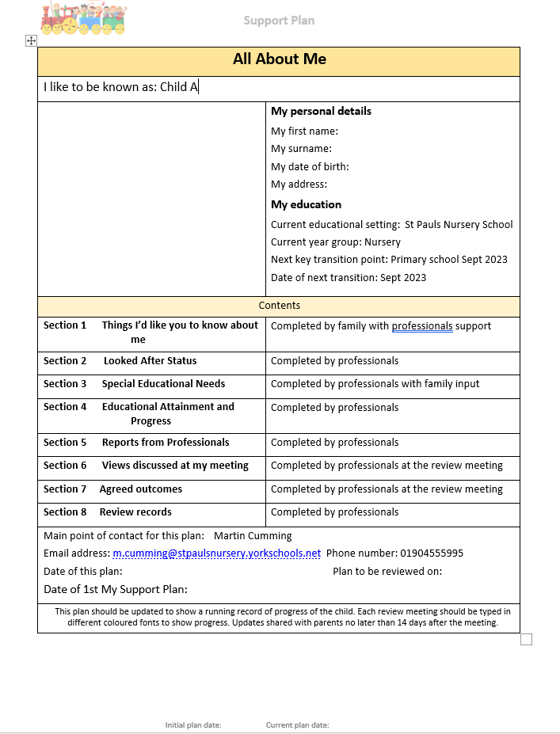
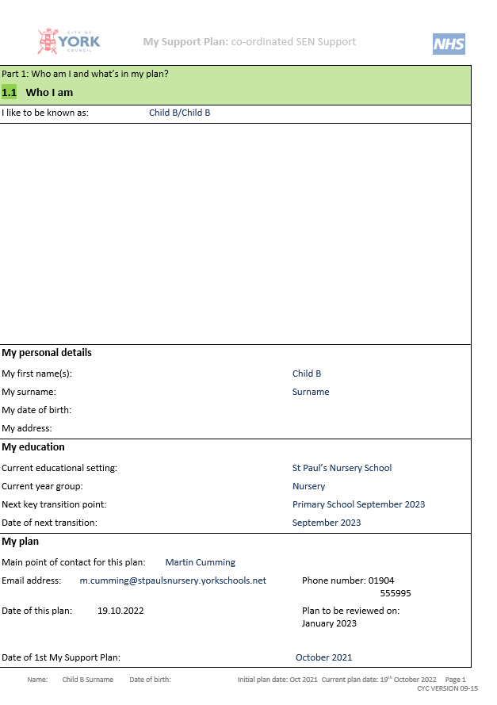
St Paul's Nursery School MSP & CYC MSP Format
Available to download here.

Slide 22
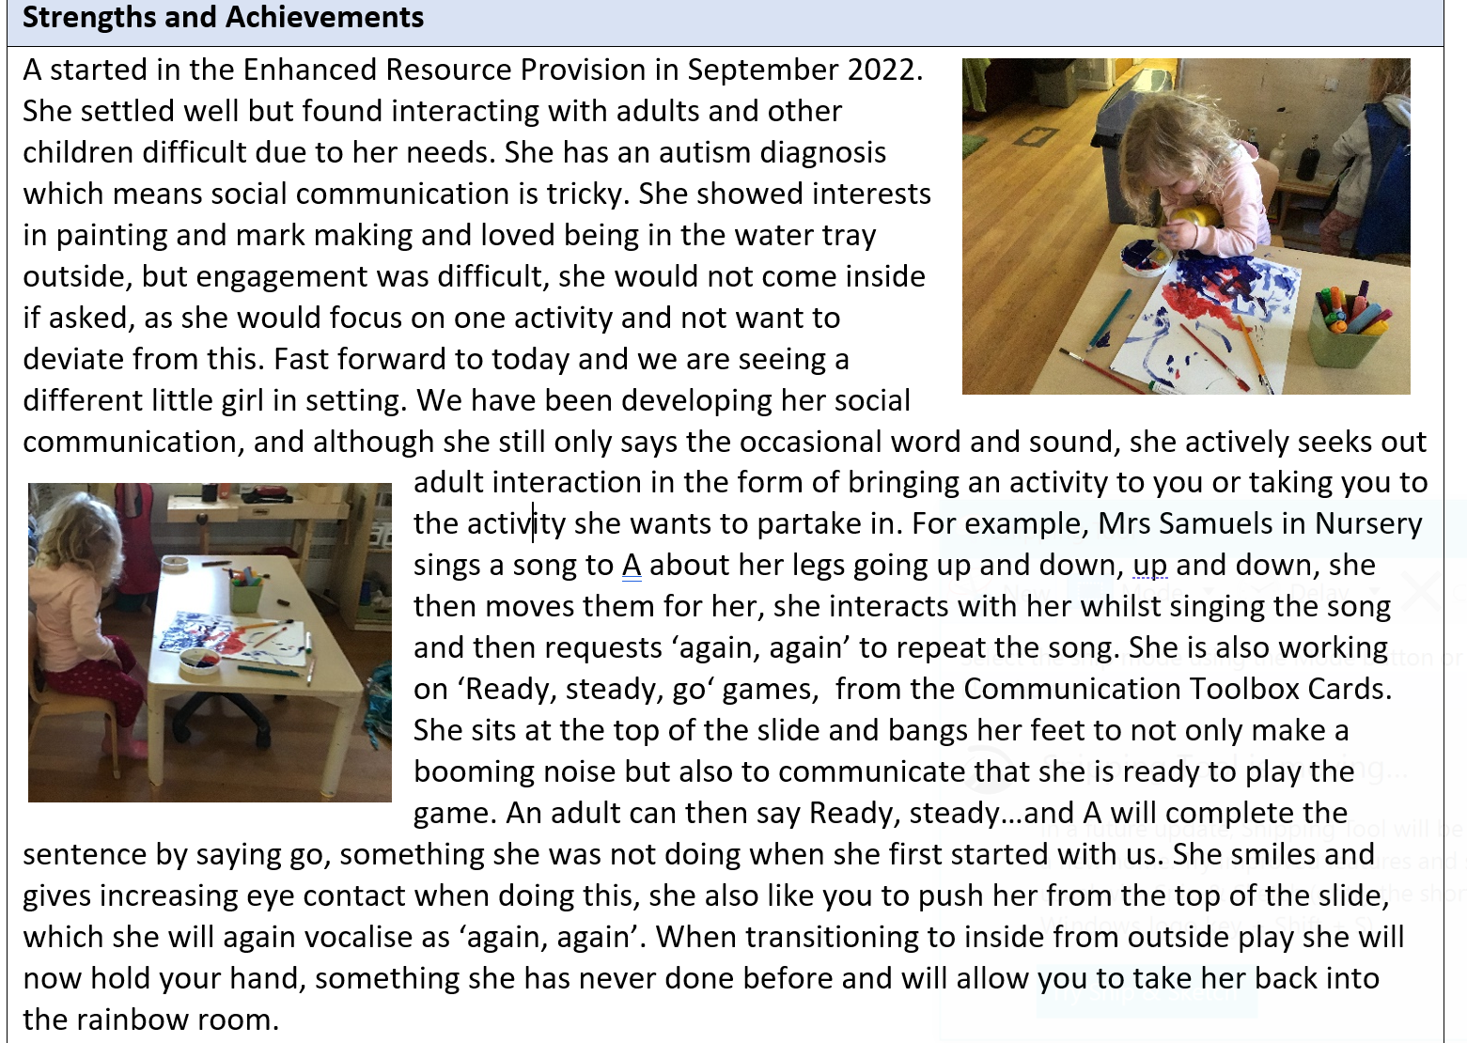

Slide 23
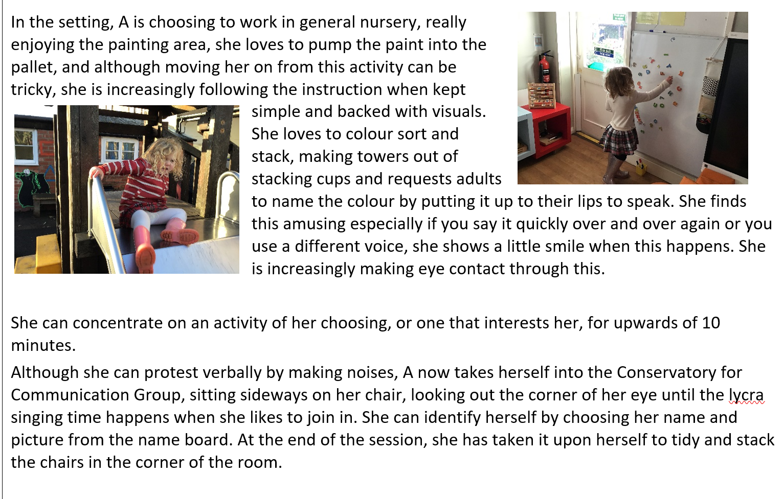

Slide 24
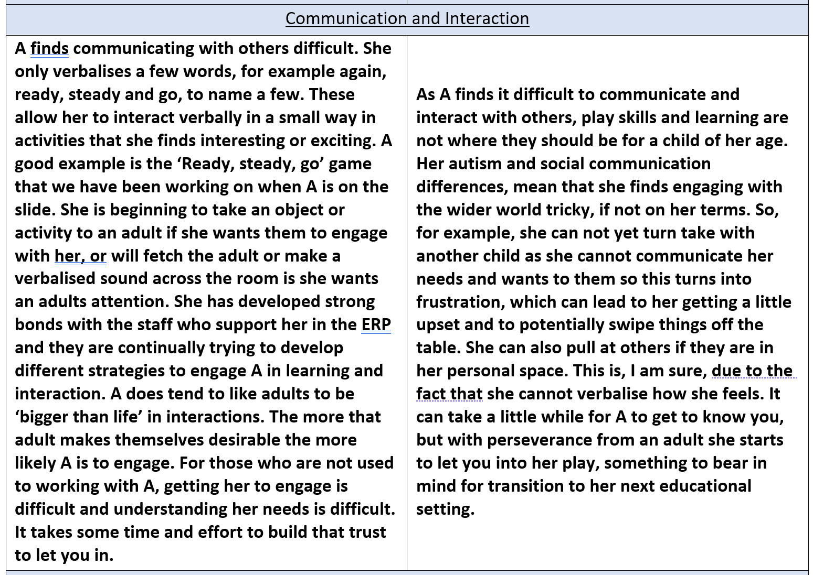

Slide 25
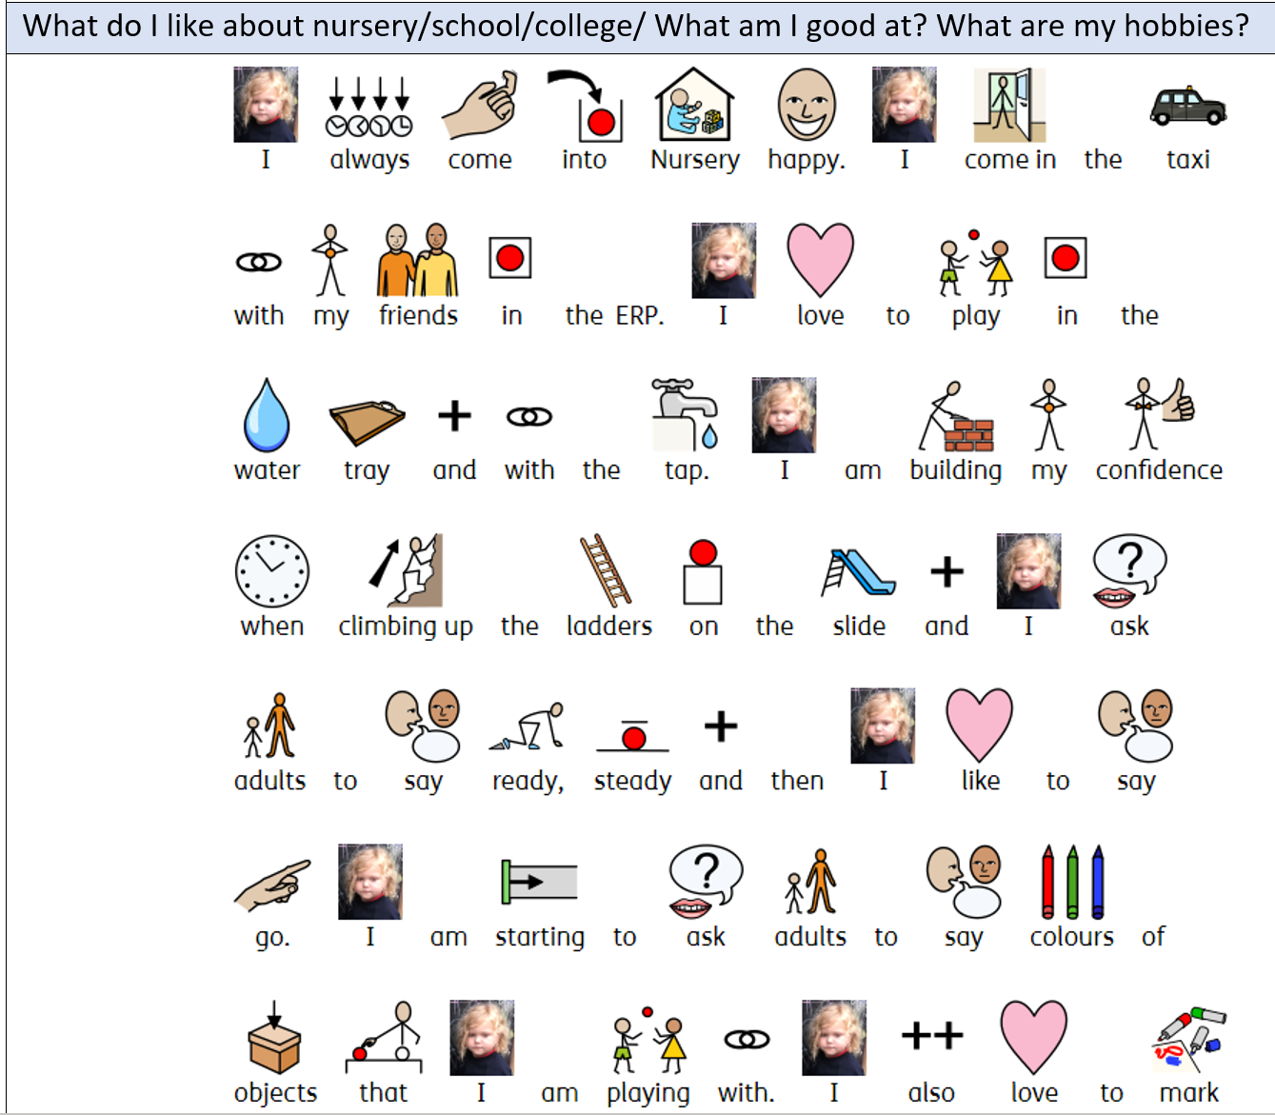
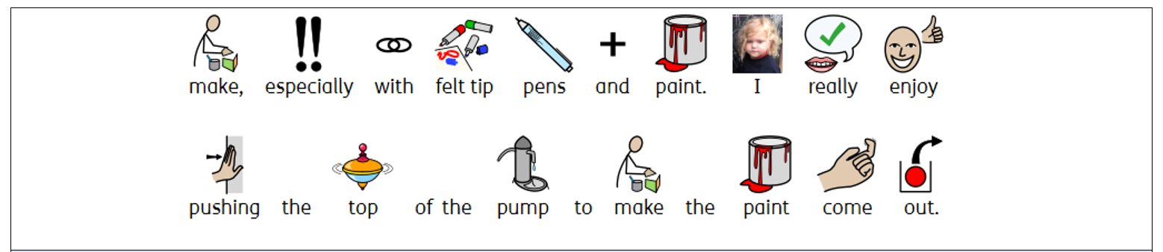

Slide 26
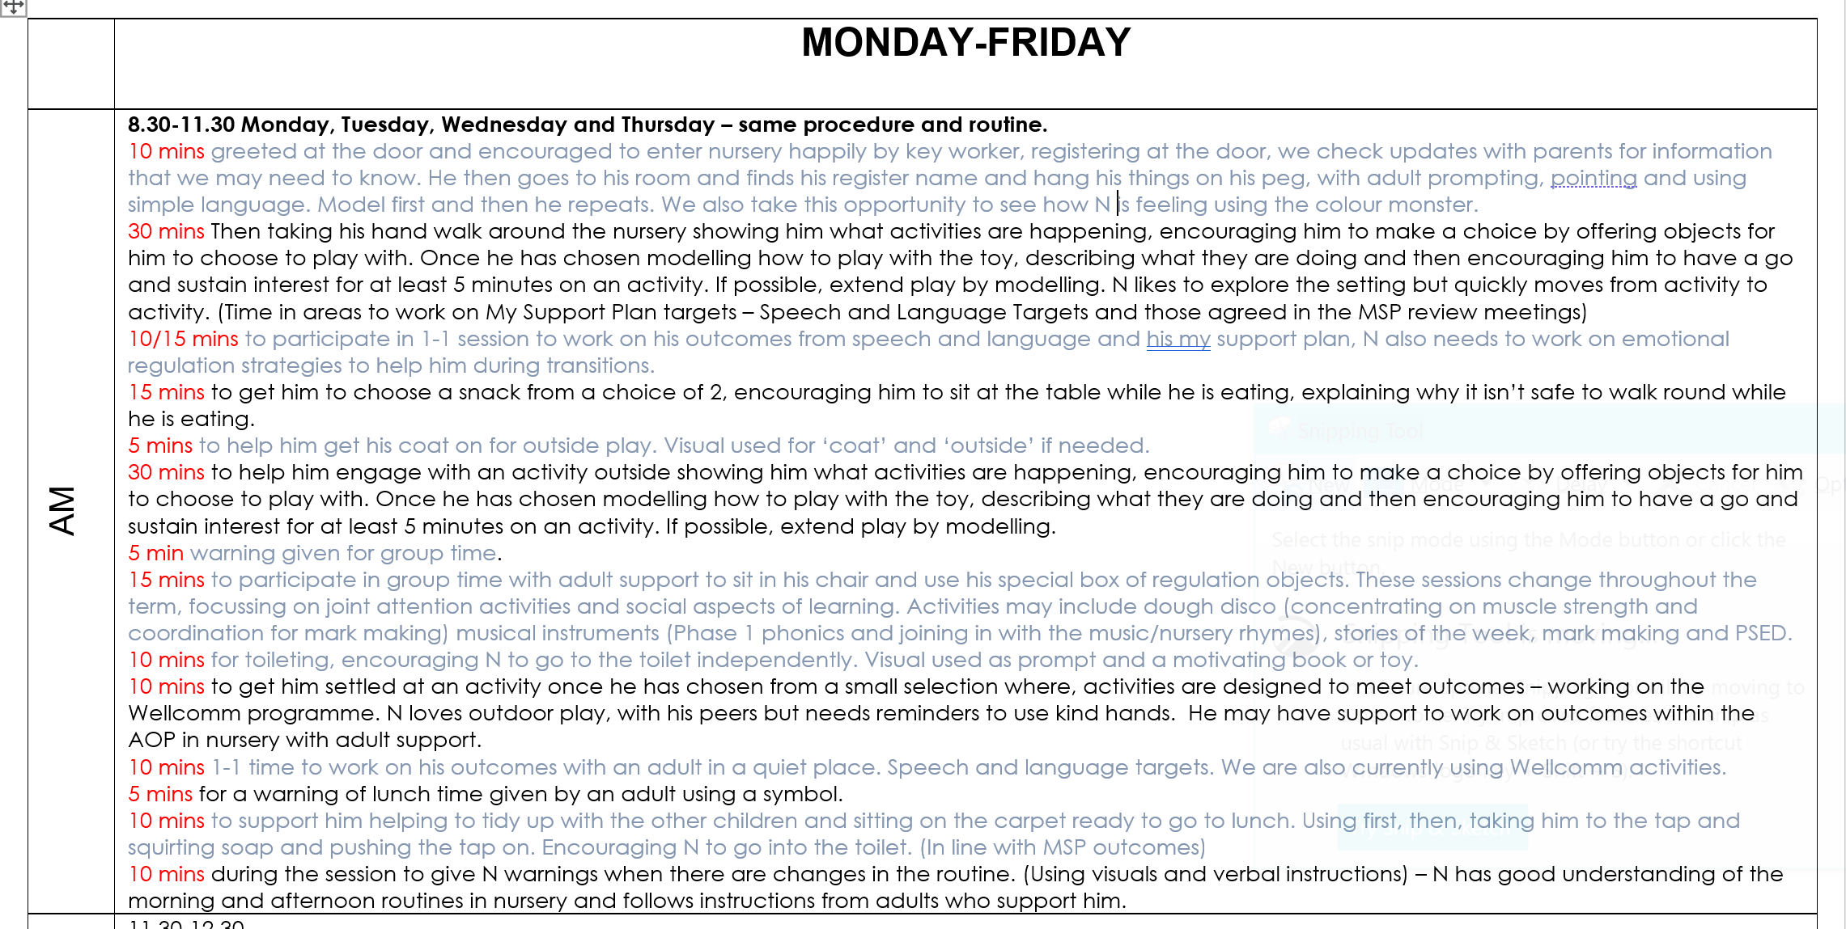

Slide 27
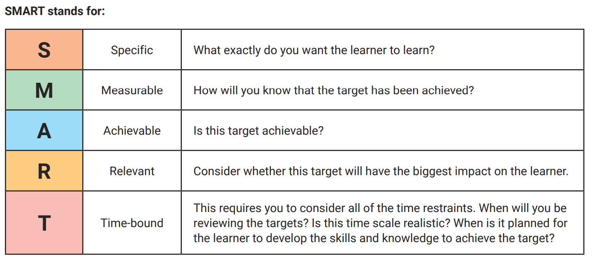

Slide 28
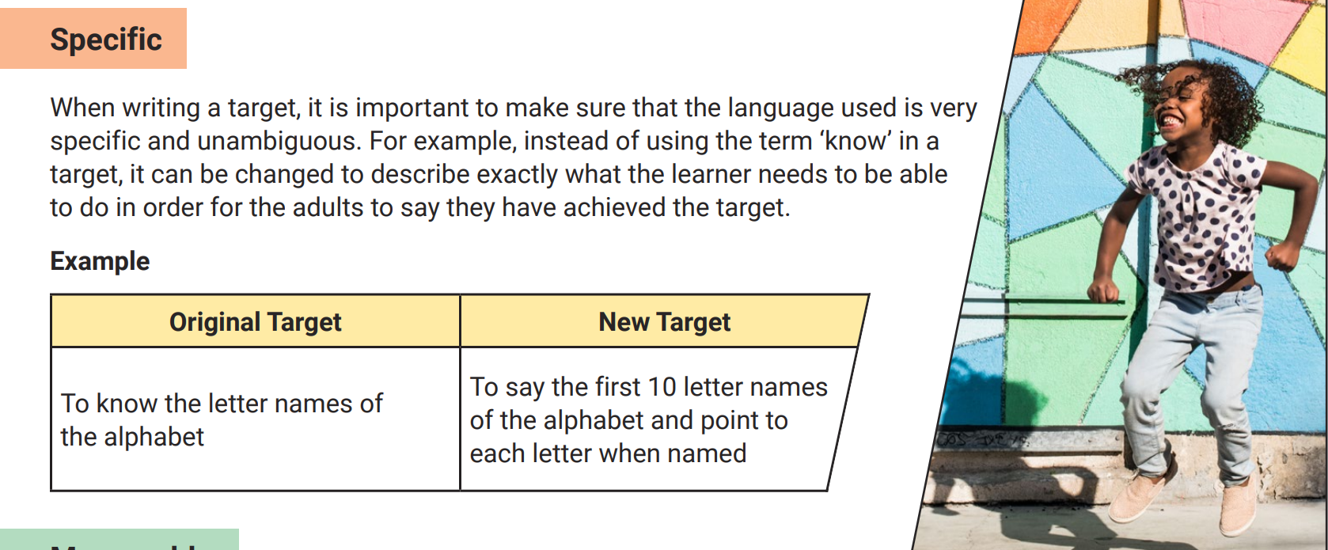
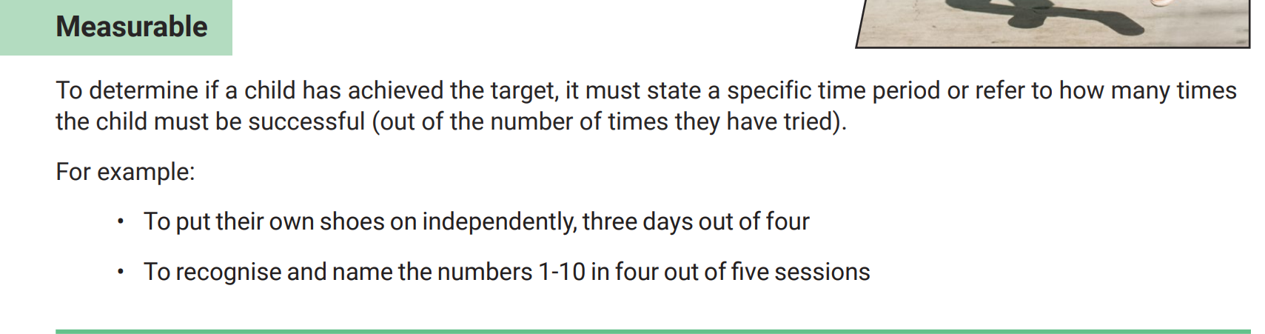

Slide 29
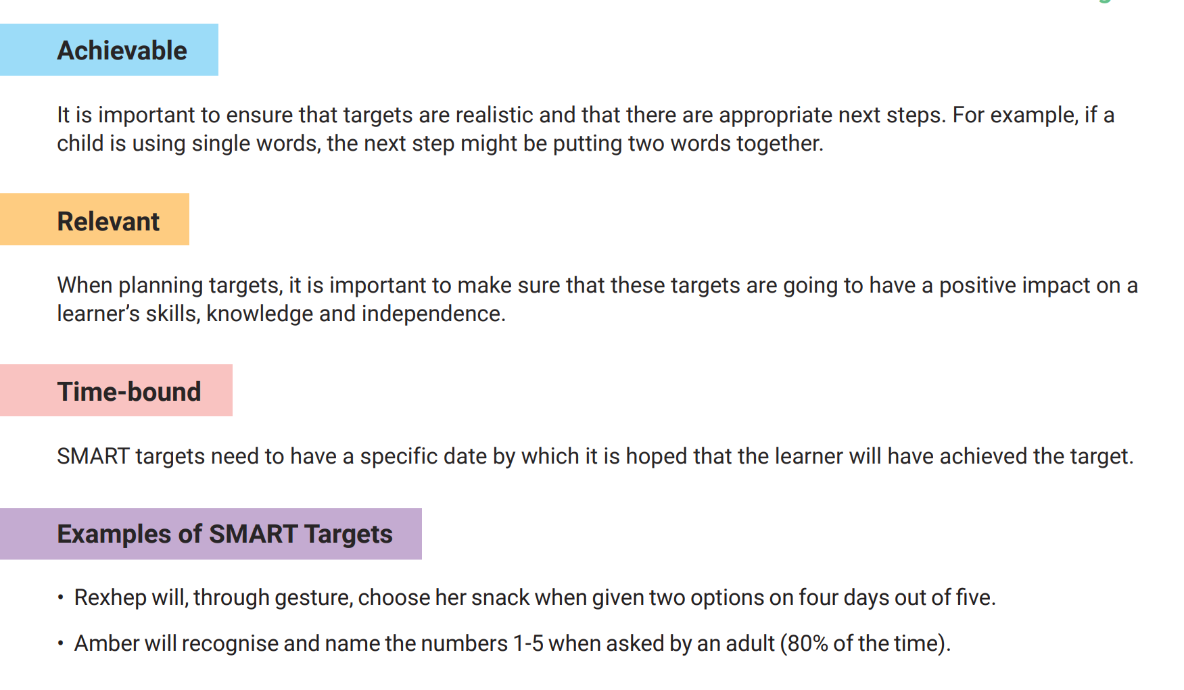

Slide 30
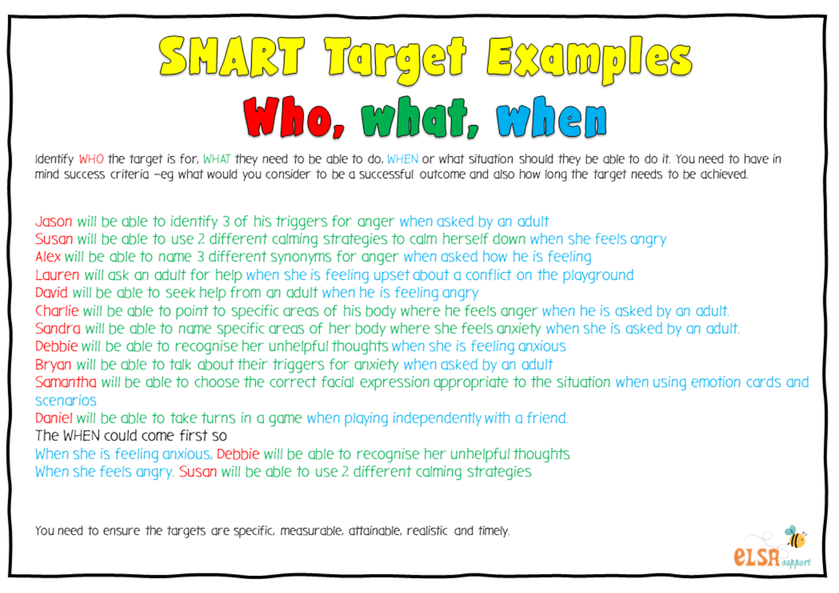

Slide 31
Are these SMART?
Joseph will lace his shoes, when given verbal instructions.
Ihram will name red, when given the initial sound prompt ‘It’s’ r, r,
Sarah will walk, when the adult holds both her hands and she is wearing her gaiters,
Lucy will put the third brick on top of the tower of two bricks, when the adult holds two bricks to steady them,
Tia will vocalise her choice of snack four days out of five
Sam will put a six piece puzzle together, without any adult help,
Charlotte will select objects when asked by an adult 4/5 times
Laurie will name 6 farm animals,, 5/6 tries
Max will join in with the last few words of a familiar rhyme or song, as part of a small group 60% of the time by the end of the half term.

