Slide 1





LEARNING SUPPORT HUB EARLY YEARS
Presented by
Claire Rigden

Slide 2
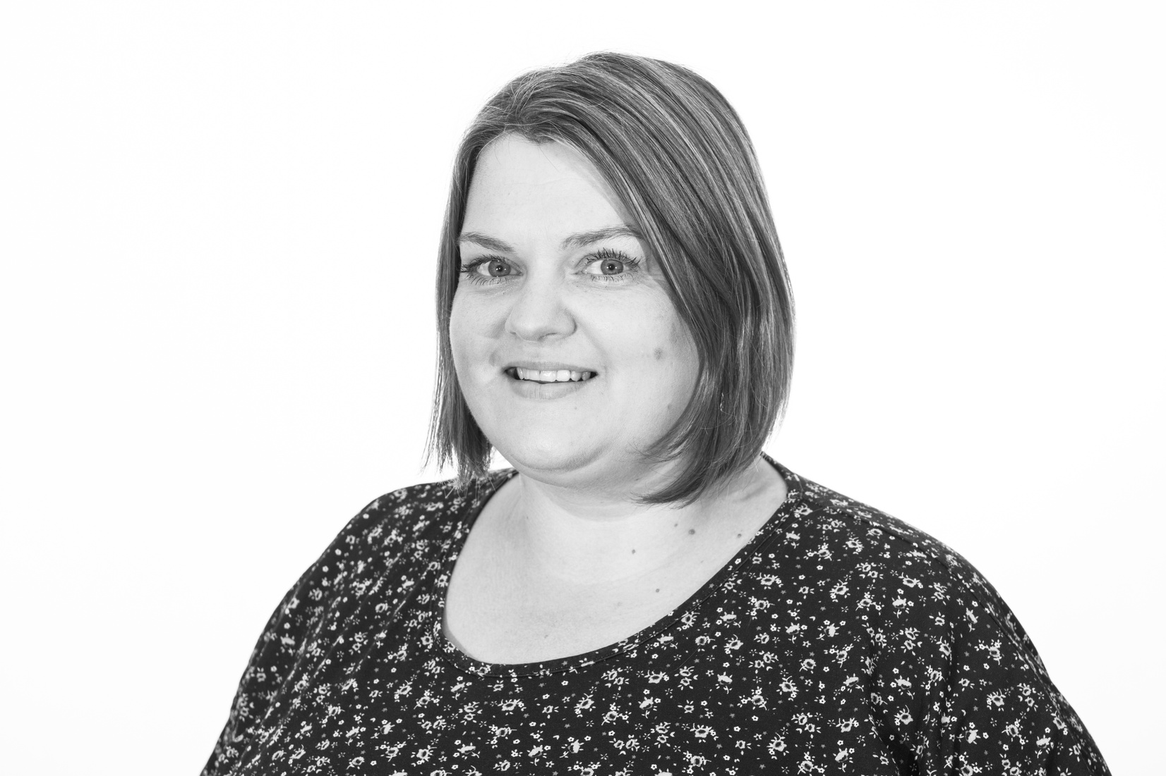
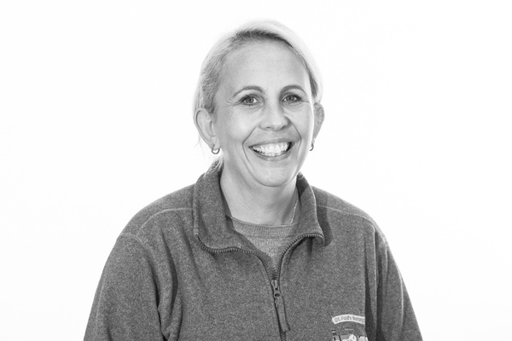
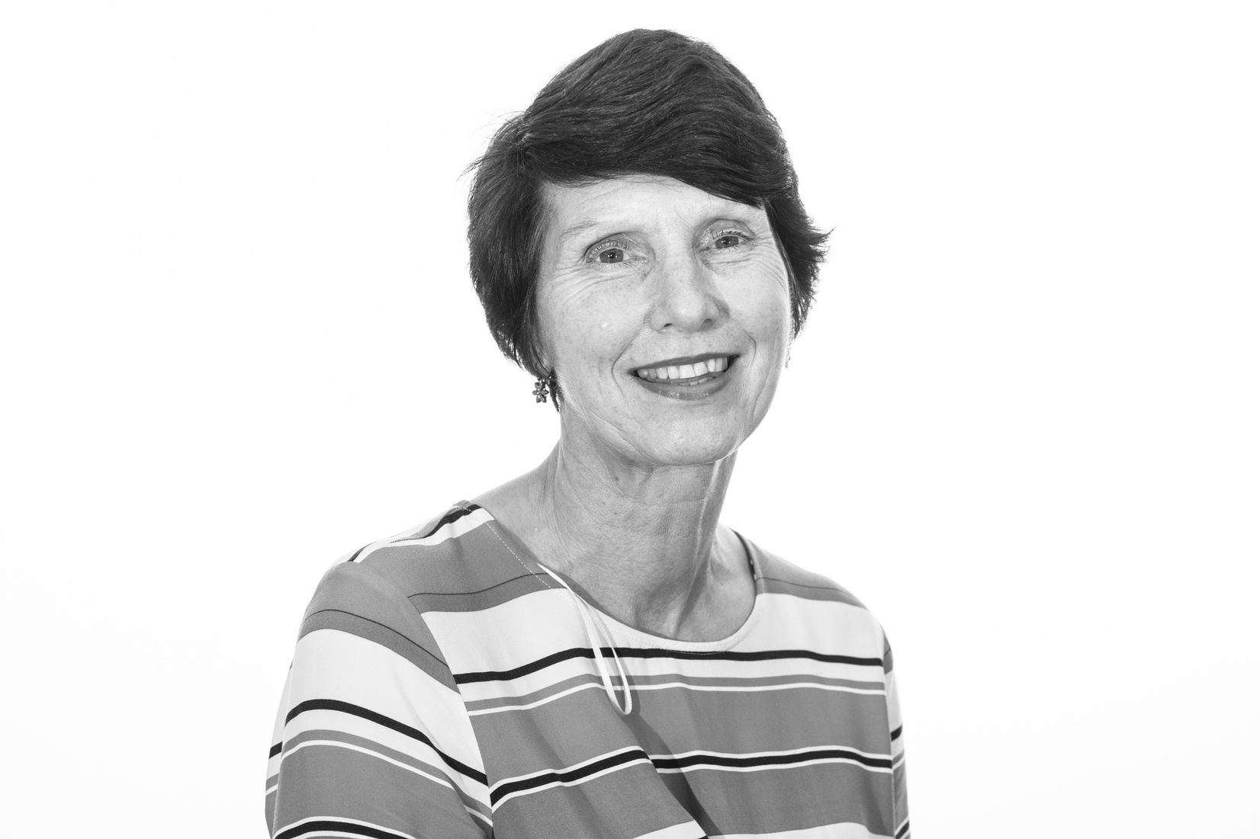

MEET THE TEAM
SARAH LOMAS
AMANDA WILLOUGHBY
SANDRA CAIRNS

Slide 3



WHAT DO WE DO?
The aim of the Learning Support Hub is to bring together all of the agencies across the city that have the expertise and skills to support children with a wide range of needs: from hearing loss and visual impairment, autism, cognition and learning, home tuition, physical needs, health and social care.
.

Slide 4

WHAT IS THE PROCESS?
1
2
MAKE A REFERRAL USING THE TEMPLATE
REFERRAL DISCUSSED AT PANEL
3
TIME LIMITED INTERVENTION TAKES PLACE
4
SETTINGS HAVE UPSKILLED STAFF SO CHILDREN THRIVE!

Slide 5

UNIVERSAL VS TARGETED?
1
2
Universal Offer
Targeted Support
The LSH may feel that your request could be met through signposting to universal training, accessing the helpline or direct email support in which case you will be informed of what is on offer that might meet your needs.
The LSH feel the setting has put in a detailed referral with clear outcomes identified and then signpost it to the appropriate team. They will then be in touch to arrange further contact and visits.

Slide 6
WHAT SHOULD I EXPECT?
Observation
1
2
Discussion
25%
25%
A staff member will visit, observe the child, discuss your desired outcomes and formulate a plan.
The following visit they will bring ideas and resources that they feel will meet your requirements.
Modelling
3
4
Implementation
25%
25%
Staff will model strategies for you with the children and describe methods that may work in your setting.
They will the implement with you and eventually observe the methods so the practitioner feels upskilled.

Slide 7
WHAT PAPERWORK IS INVOLVED?
  Staff will share with you their initial thoughts around strategies and ideas that will work.
  They will keep an informal record of their visit for internal moderation and monitoring. (available on request)
  Settings should feel involved in professional support throughout the process.
  Written reports will NOT be provided, the support is identified to be practical and time limited, time writing reports would detract from that.
  The practitioners will be happy to provide or signpost you to resources such as visual timetables where they have access to them.
  fFnal feedback will be asked for and this is fed back to the local authority to monitor quality and adapt the offer to meet settings needs.

Slide 8
WHAT IS NOT INVOLVED?
  This is practitioner to practitioner support, all staff use these strategies every day in their own setting.
  We are not allowed to:
  attend MSP meetings
  write reports
  give outcomes (although we can coach settings to identify next steps themselves.)
  talk about children who have not been referred and permission given.
Anonymous advice can be given via email to eysupport@york.gov.uk or phoning the helpline 555133

Slide 9





COME & SEE THE EARLY YEARS ERP!
OBSERVE, CHAT AND SHARE IDEAS
FREE DROP IN SESSIONS @ ST PAUL'S NURSERY SCHOOL
01904 555995
BOOK ONLINE:
HTTPS://KOALENDAR.COM/E/OPENSESSIONERP
EYSupport@york.gov.uk

Slide 10


